Slide 1
Field 3D PTV v1.0
Flow Field Imaging Laboratory, University of Minnesota

Slide 2
Outlines
Product description
Hardware
Hardware overview
Detailed description of key components
Software
Software overview
Detailed description of software used
Image Acquisition procedure
Data processing procedure
Demonstration cases
Case I: Confetti Settling
Case II: Snow Settling
Case III: Pollen Dispersion

Slide 3
Product Description

Slide 4
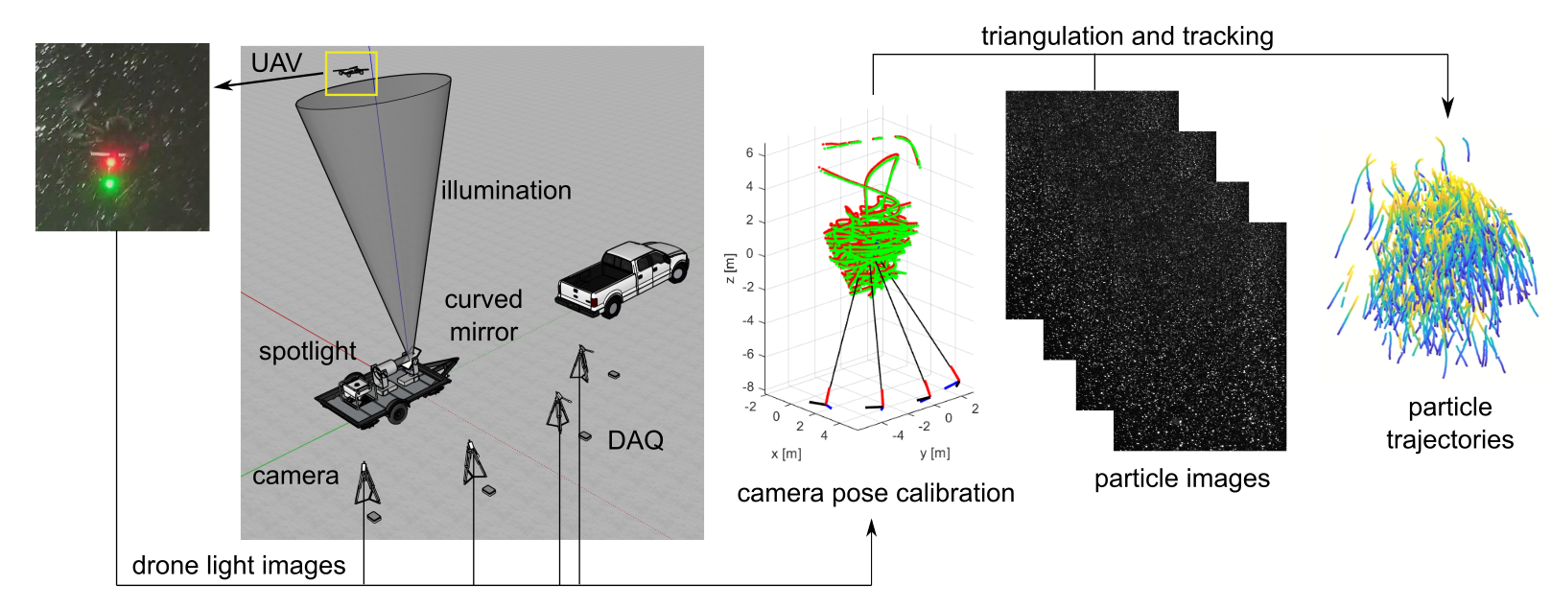
Field 3D PTV System v1.0 Overview
Hardware: a WiFi-controlled four-camera multi-view imaging system for data recording and a drone with two-color LED spaced in a fixed distance for calibration
Software: Remote camera control for field data acquisition, EasyWand code for calibration, and OpenLPT for 3D particle reconstruction

Slide 5
Hardware

Slide 6
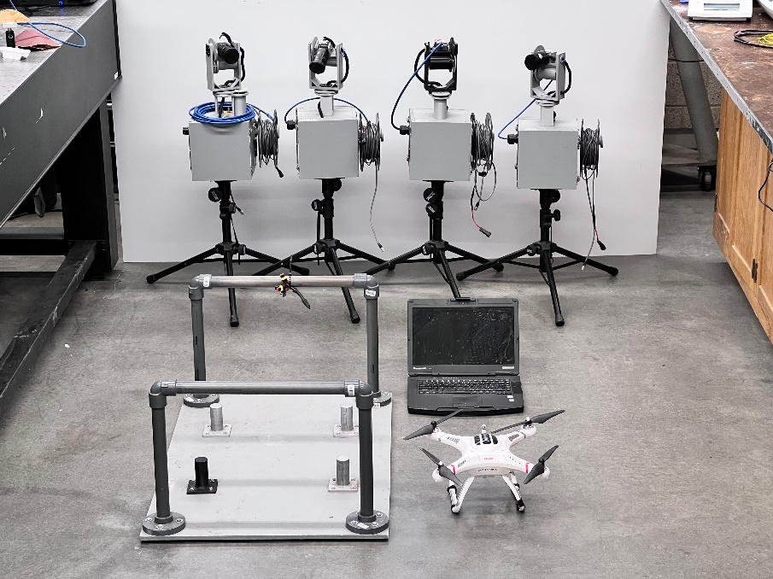
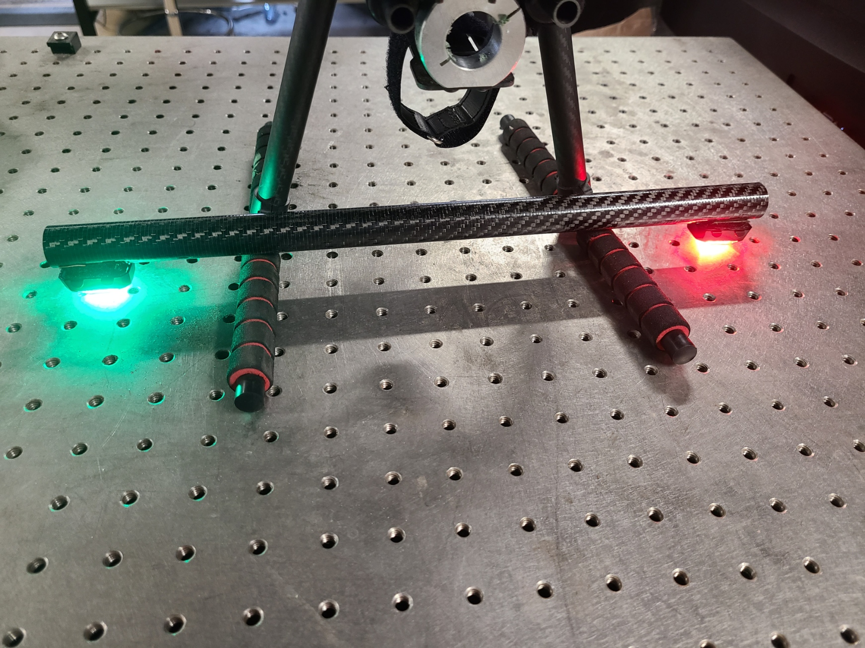
Hardware Overview
Imaging module
Central computer
Drone for carrying calibration component (optional)
Customized mounting platform
Calibration bar
Main hardware components
Imaging module for acquiring and storing PTV data
Central computer for controlling camera alignment and data acquisition
Calibration module for camera alignment and 3D image reconstruction
Lighting module for enhancing the signal in the desired sample volume (optional)
Entire imaging hardware component can be transferred through a customized mounting platform
Notes:
Notes:
Hardware components: ~\Hardware\Open3DPTV_v1p0_component list.xlsx
Imaging module (the four boxed units): camera, motorized stage, data processing, data storage, tripods
Lighting module: optional depending on the background; some cases (e.g., pollen dispersion) use sun light.
Calibration module: red and green LED attached to a carbon tube, with 34.5 cm gap

Slide 7
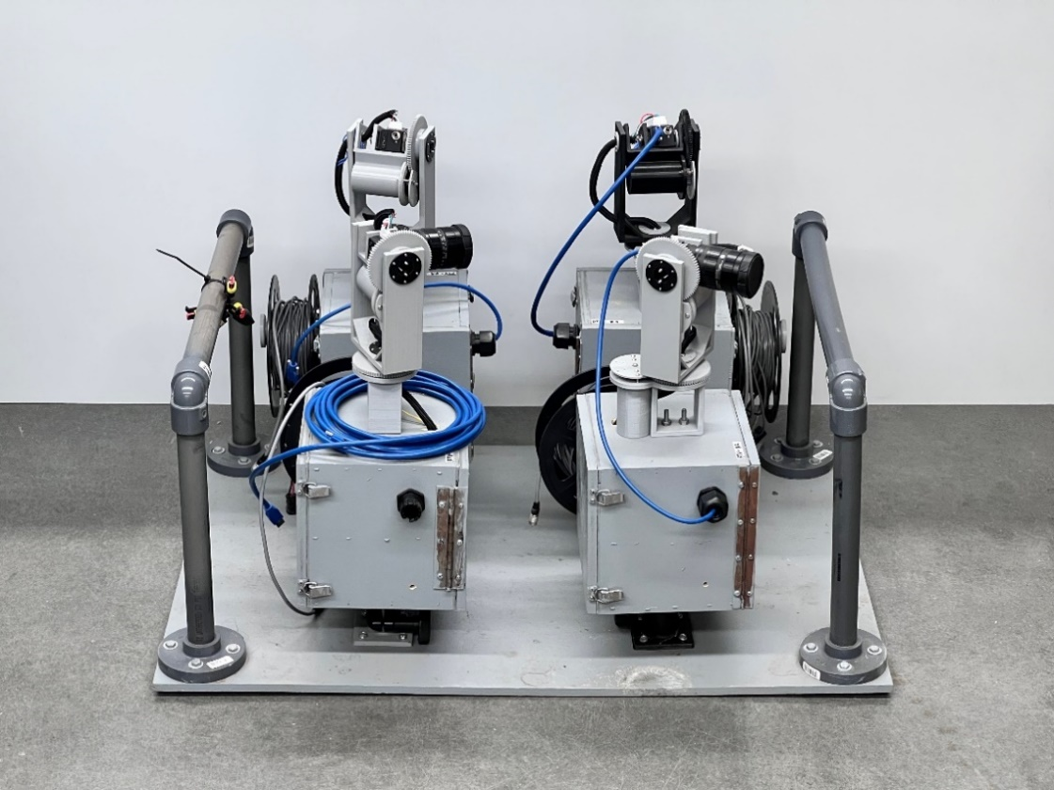
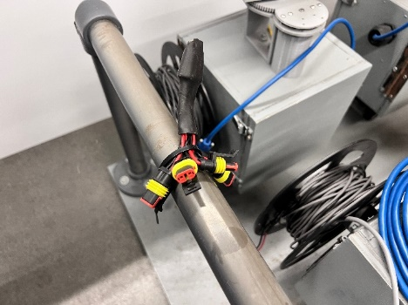
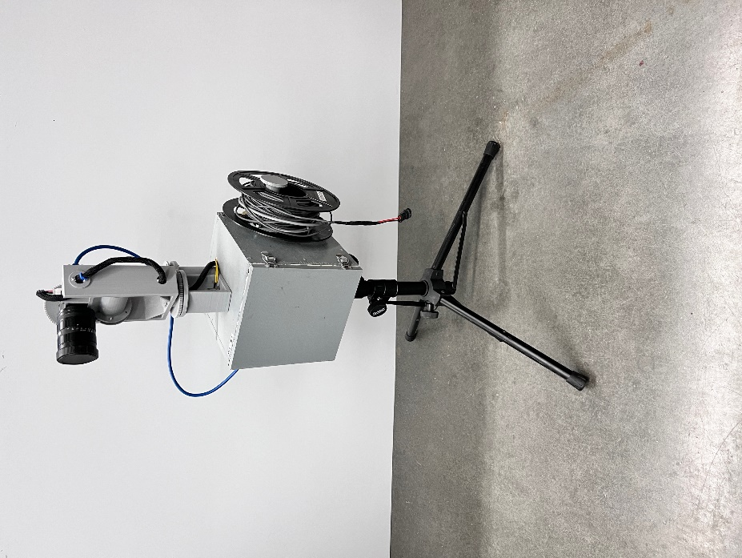
Imaging Module
Imaging units
Camera
Magnetometer and accelerometer
Motorized stage
Spools for sync cables
Synchronization Cable
Include four imaging units, protective wooden boxes for easy setup, each mounted on a tripod
Cameras are synchronized via sync cables, with one master imaging unit controlling three slave units
Each imaging unit includes a camera with a lens attached, a two-axis motorized stage for camera mounting and alignment, and GPS sensor. Data acquisition board are inside the wooden box enclosure
Notes:
Notes:
Camera: 2.8 Megapixel at 95 FPS
Lens: 16 mm f/1.4
Two-axis motorized stage: one axis for pitch control with acceleration sensor attached and one axis for yaw control with magnetometer attached (design files in ~/Hardware/Gimbal system/Printed Gimbal)
Data acquisition board: Nvidia Jetson Nano
GPS sensor
Box enclosure: 20 cm x 20 cm x 20 cm in dimension (design files in ~/Hardware/2nd Gen PTV Box)
Platform dimension: 92 x 64 cm

Slide 8
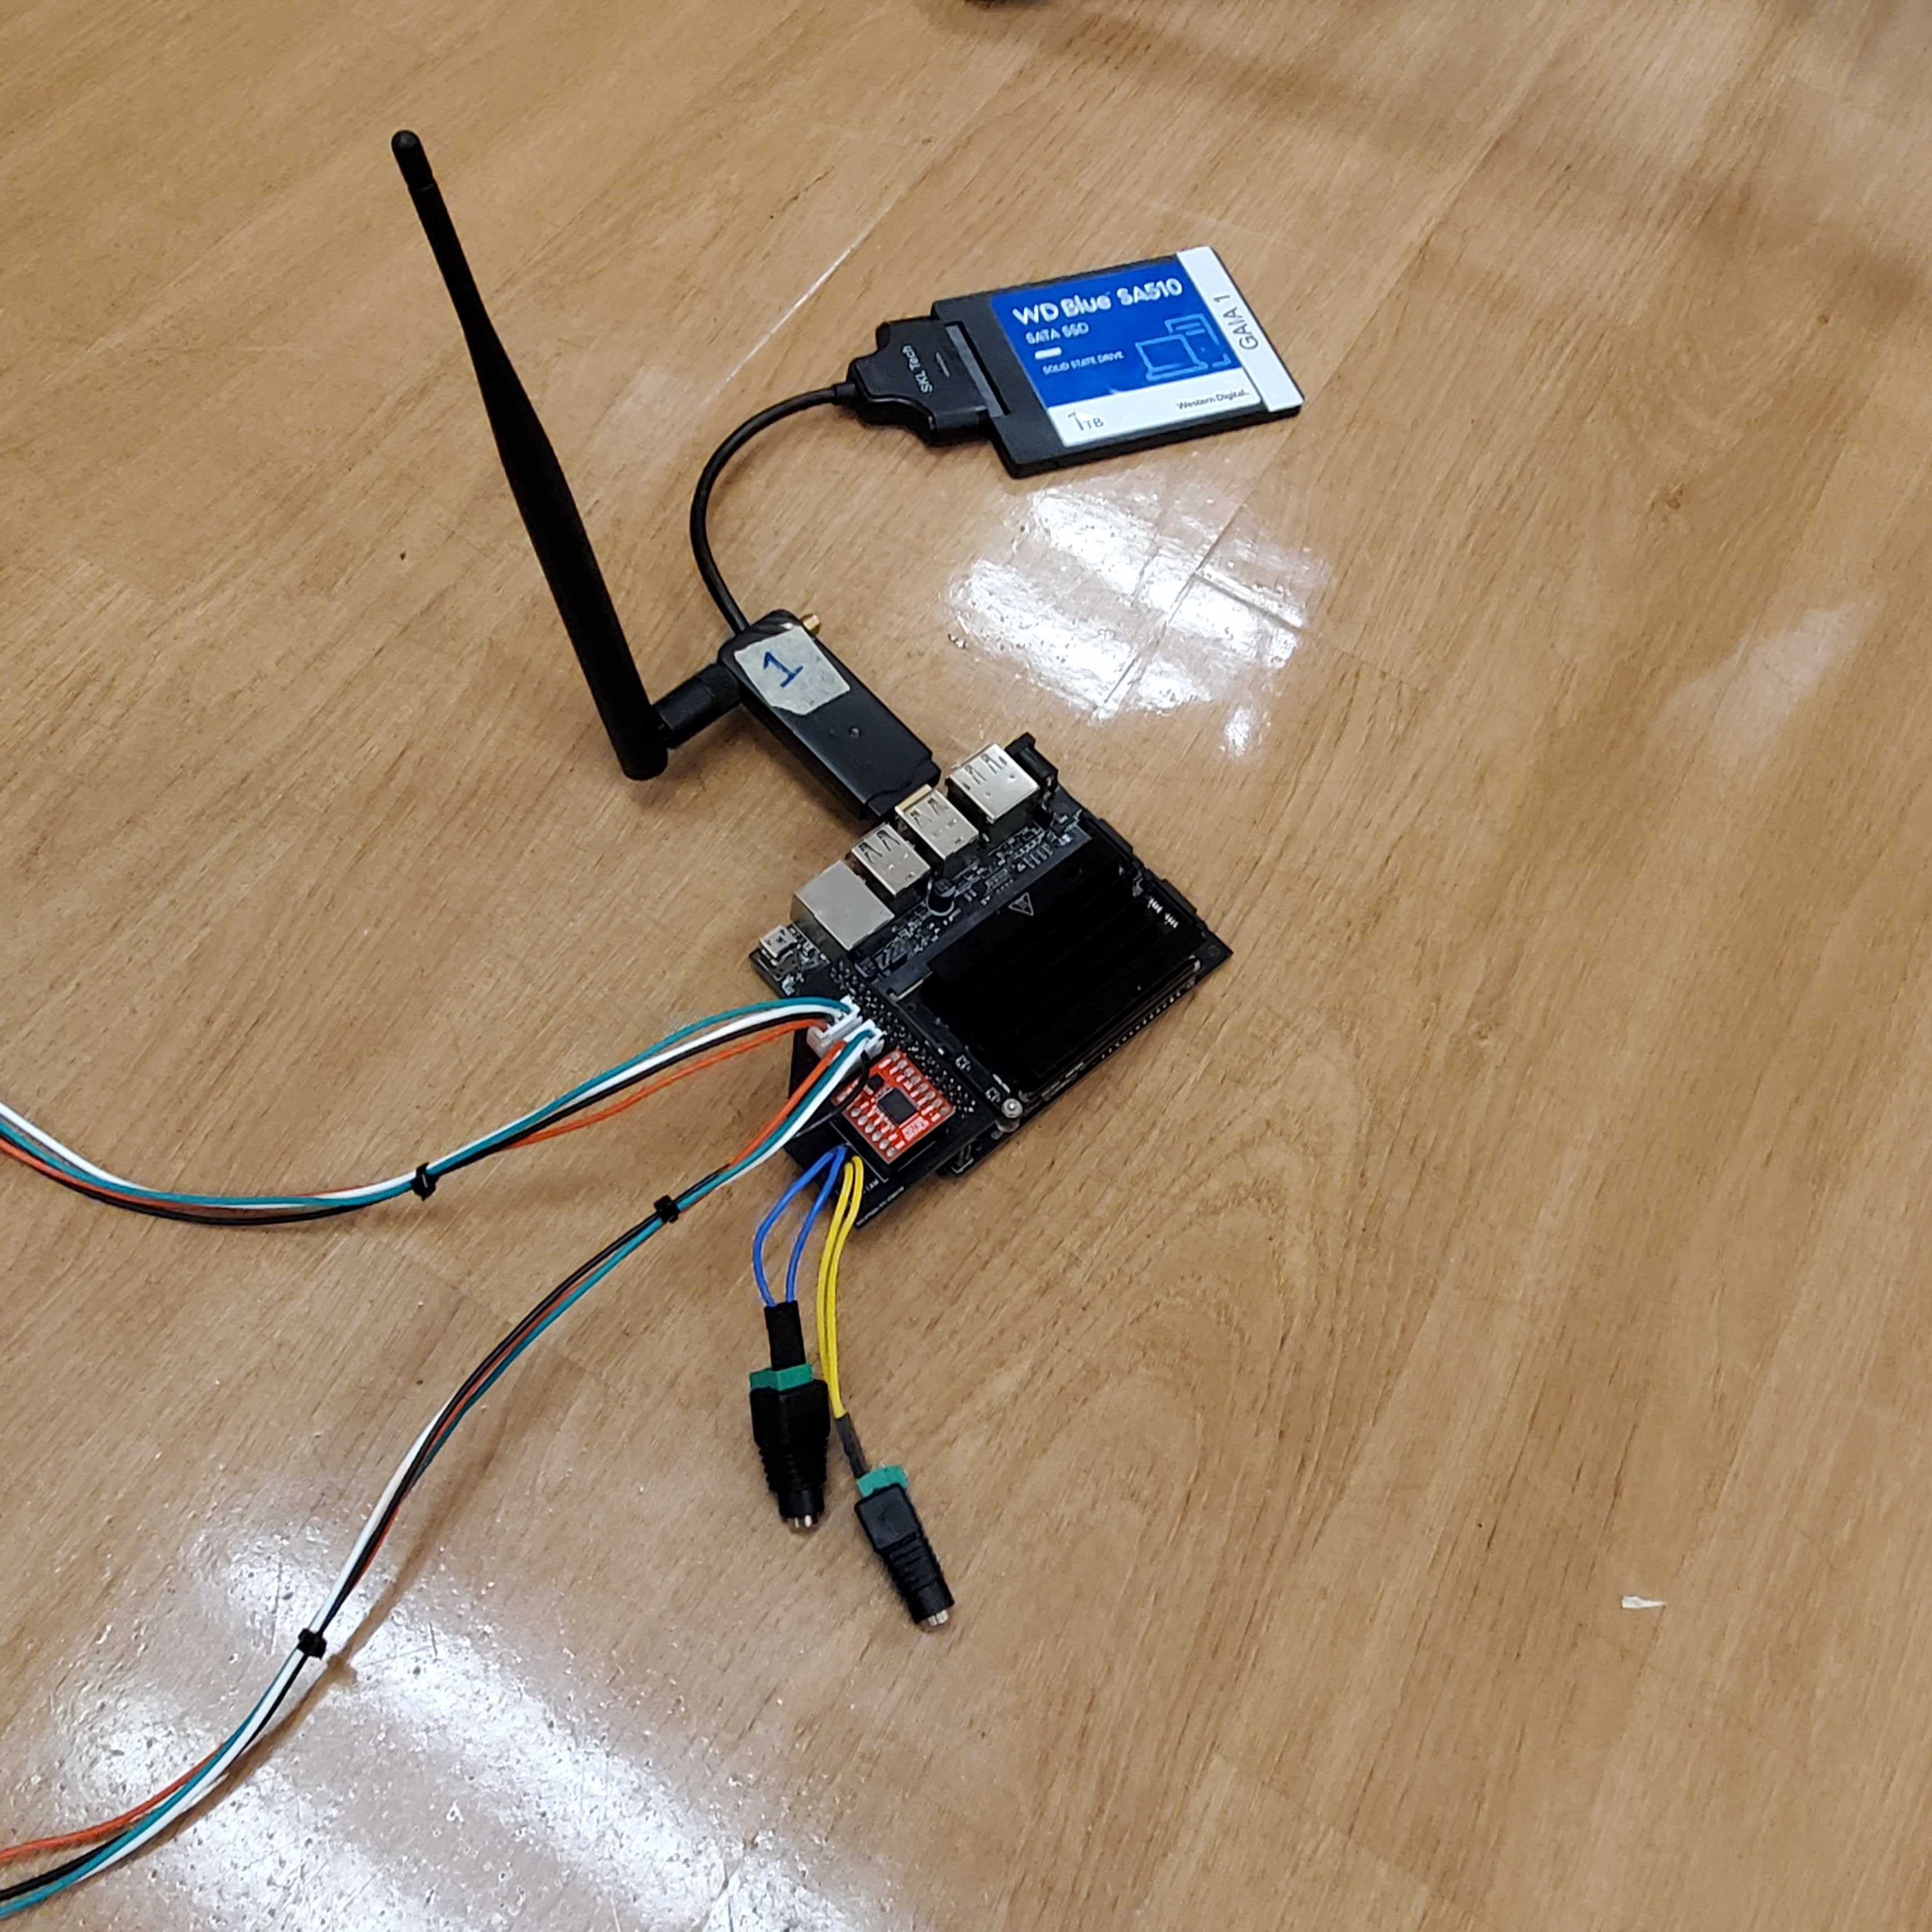
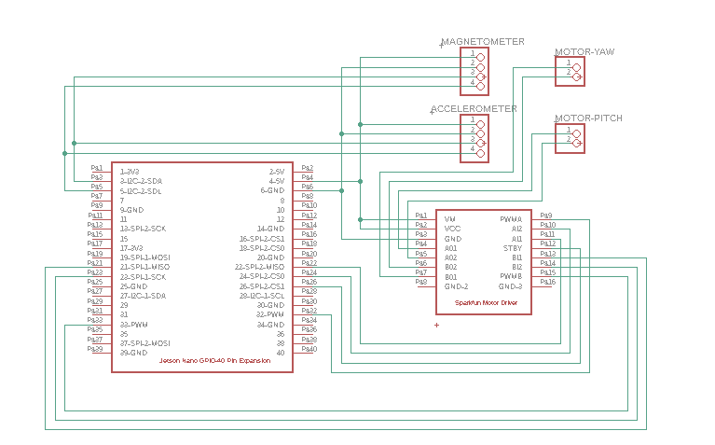
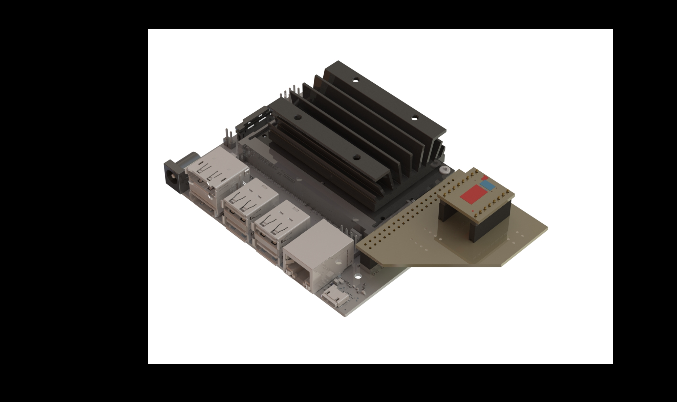
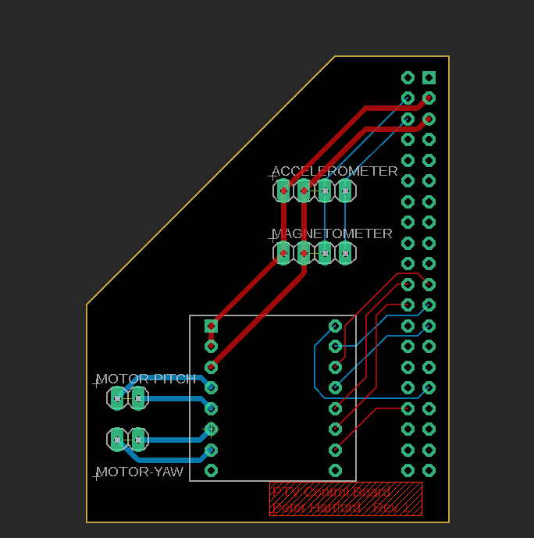
Imaging Module: Camera and Motorized Stage Control
SSD hard drive
NVIDIA Jetson Nano
Motor driver
Motor control
Camera, WIFI adapter, and SSD hard drive connected to Jetson Nano directly through USB ports
Sensors (magnetometers and accelerometers) and motors (pitch and yaw) connected to a custom PCB board attached to the Jetson Nano, with header pins and wired connections designed for easy replacement
SSD hard drive held within the boxes and stack with the Jetson Nano and board
Sensor control
Custom board
Notes:
Notes:
PCB design file location: ~/Hardware/Gimbal system/PCB Files
Motorized stage control incudes sensors (magnetometer, accelerometer) and motors (pitch and yaw), connected to Jetson Nano through custom PCB board
Camera (blue colored cable), SSD, WIFI through USB port

Slide 9
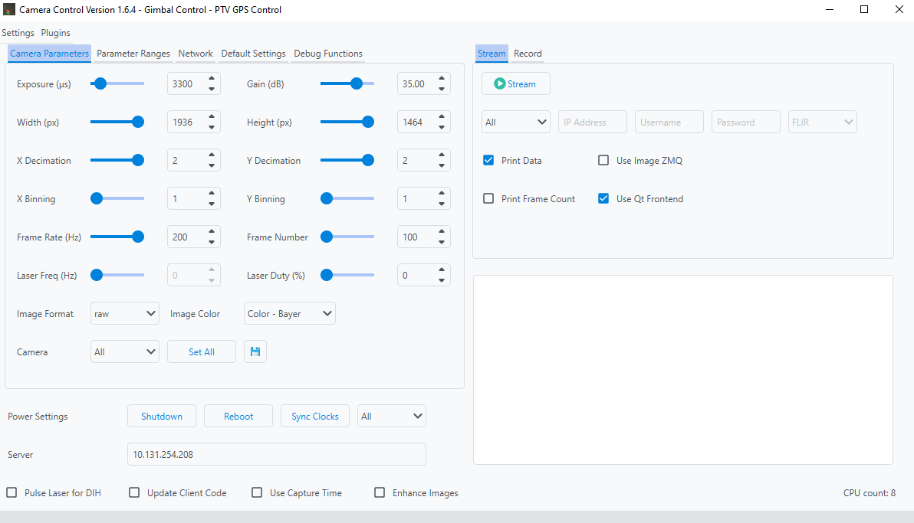
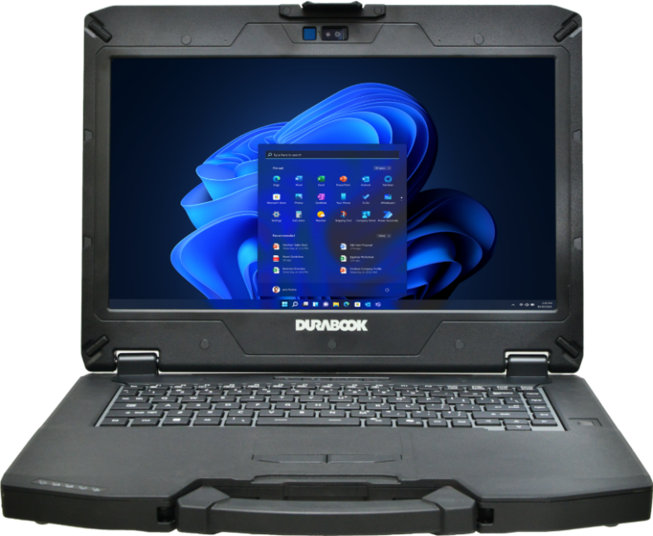
Central Computer for Data Acquisition Control
Filed laptop for deployment
Required Software: Remote Camera Control (latest version: v1.66)
Calculates camera spacing based on measurement volume and height
Integrates with the GPS control plugin to provide feedback control for motorized stage positioning
Manages imaging settings and camera recording functions
Notes:
Notes:
Remote Camera Control package included in ~/Software, downloadable from GitHub
GitHub link: https://github.umn.edu/HongFlowFieldImagingLab/remote-camera-control

Slide 10
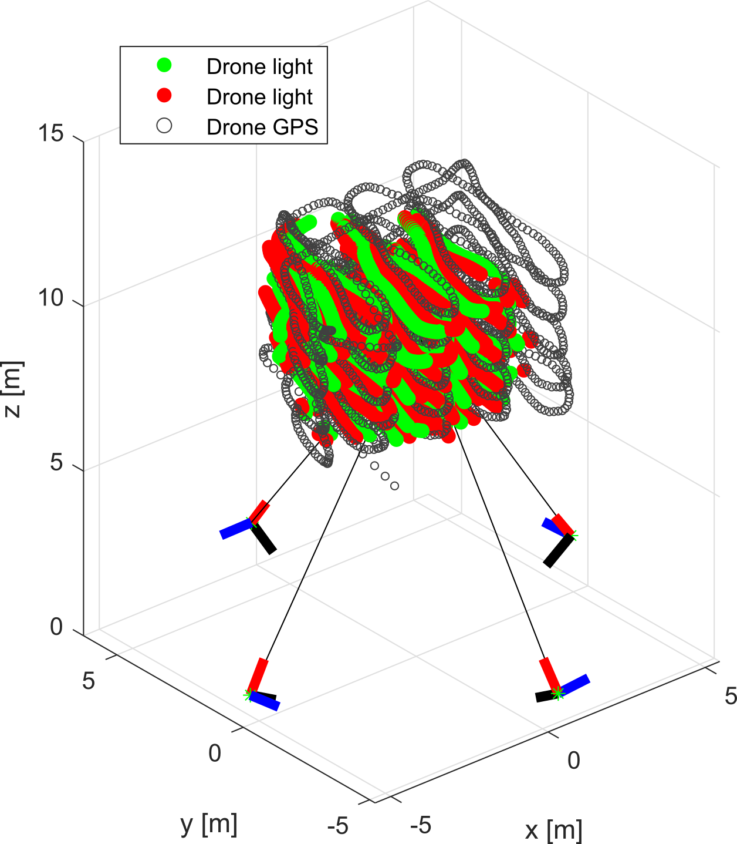
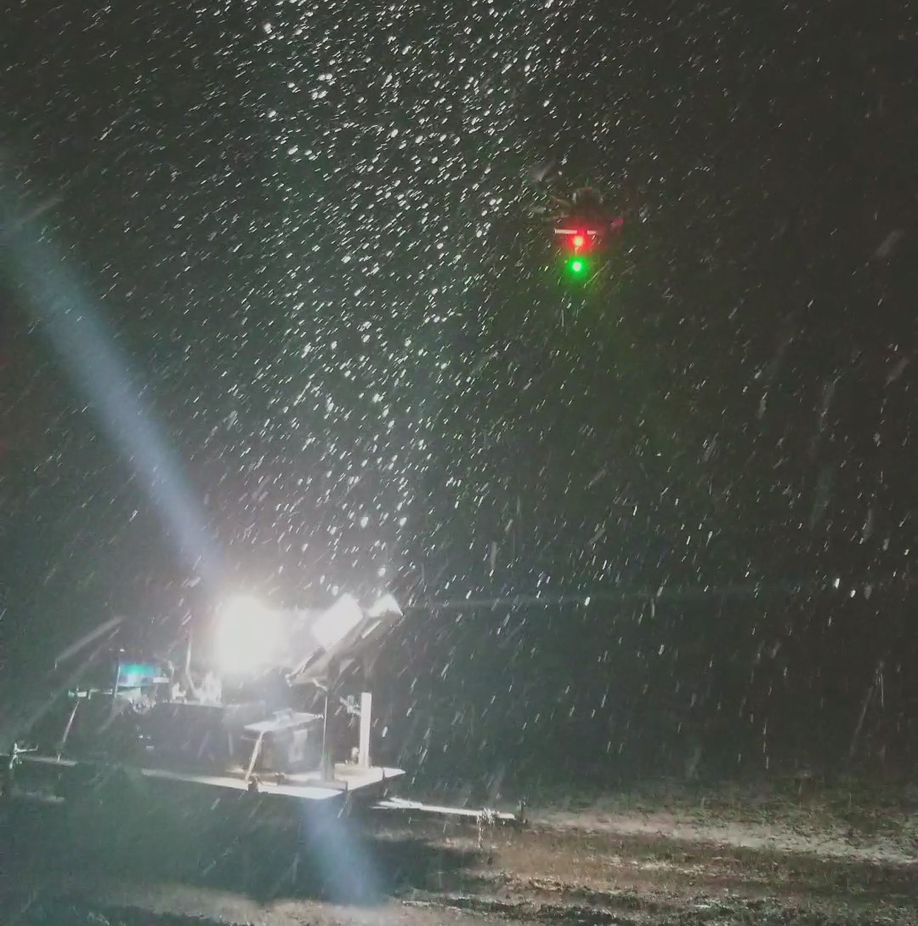
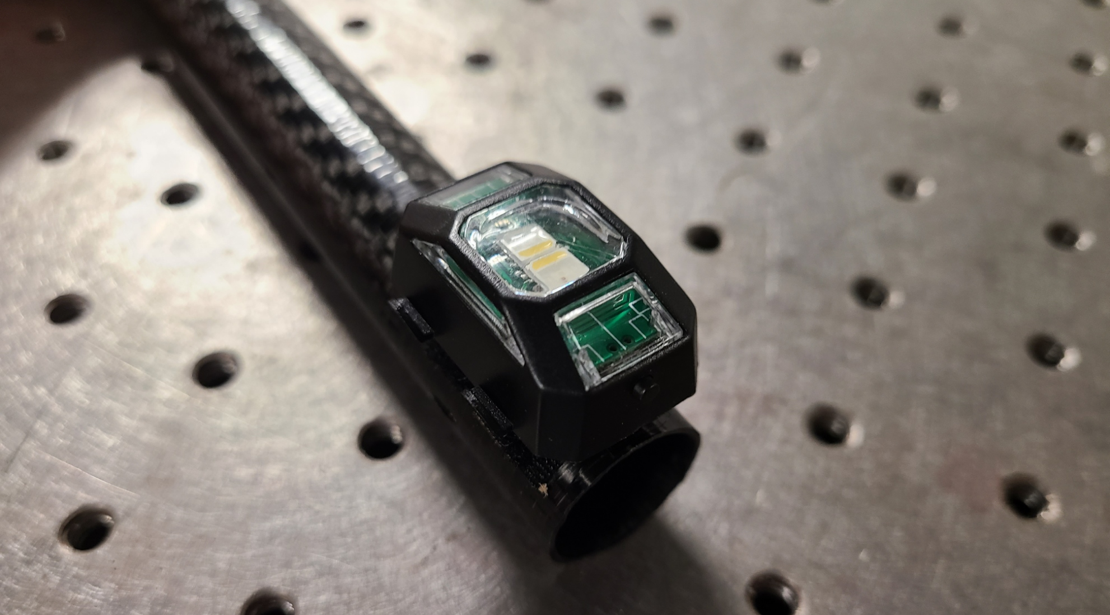
Calibration module
Calibration Overview
Calibration establishes the geometric relationship between multiple cameras
Uses a calibration bar equipped with fixed-distance red and green lights
User Tips
A drone is used to carry the bar; depending on the application, manual handling may be an option
Move the bar throughout the full sampling volume to ensure accurate calibration
Keep the bar horizontal and ensure the lights face downward during calibration
Notes:
Notes:
1. Calibration bar: the calibration scale depends on the drone used. The calibration bar used in our experiment is 34.5 cm long.

Slide 11
Software
Notes:
Notes:
Location: ~/Software

Slide 12
Software Overview
Plan
Calibration
PTV processing
Step I: 3D PTV system setup parameter calculator
Step III: Calibration
image pre-processing
Calibration
matrix
Step V: 3D PTV tracking (OpenLPT)
Acquire particle trajectories via “shake-the-box” method
User input: sampling volume dimension and height
Marker extraction
Step IV: Calibration (easyWand5)
Trajectory record
Camera settings
Post Processing
3D calibration matrix generation
Deployment
Step VI: 3D trajectory visualization
Step II: 3D PTV camera setup control
Code for trajectory 3D visualization, users can perform further analysis independently
Image acquisition: calibration image and particle image
Raw images
Notes:
Notes:
Step I (3DPTV system setup parameter calculator): ~/Software/3DPTV_Image_Acqusition/system setup parameter calculator
Step II (3DPTV camera setup control): ~/Software/3DPTV_Image_Acqusition/camera setup control
Step III (calibration image preprocessing): ~/Software/3DPTV_Processing_Pipeline/calibration image pre-processing
Step IV (3D calibration matrix generation using easywand): ~/Software/3DPTV_Processing_Pipeline/easyWand5
Step V (3D PTV tracking using OpenLPT): ~/Software/3DPTV_Processing_Pipeline/OpenLPT - ShakeTheBox
Step VI (3D trajectory visualization): ~/Software/3DPTV_Processing_Pipeline/3D trajectory visualization

Slide 13
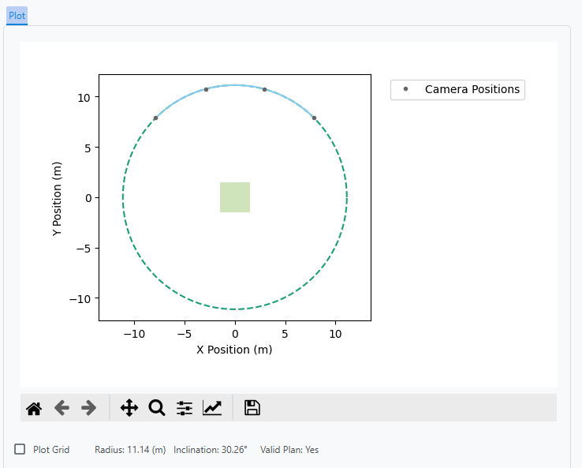
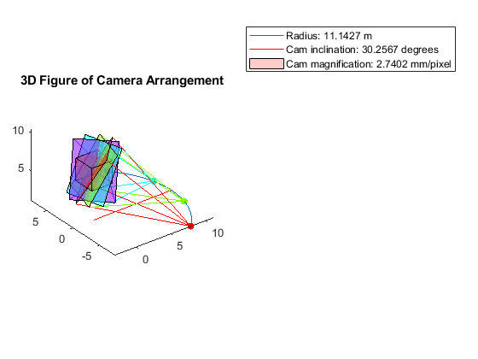
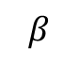
Step I: 3D PTV system setup parameter calculator
MATLAB code for determining camera location and orientation
User inputs
Sampling volume dimensions and location (center height to the ground)
Radius of cameras
Camera parameters
Spherical working distance derived from sampling volume dimension
Camera position and orientation (yaw and pitch) calculated based on above inputs
Planed camera locations
Planed camera yaw and pitch
Spherical working distance approximation
Sampling volume
Height to the ground
Distance
Notes:
Notes:
Input parameter examples: 6 m x 6 m x 6 m with center of sample volume at 12 m above the ground.
Camera parameters can be found in the hardware section
Software location: ~\Software\Multicamera System Calculator

Slide 14
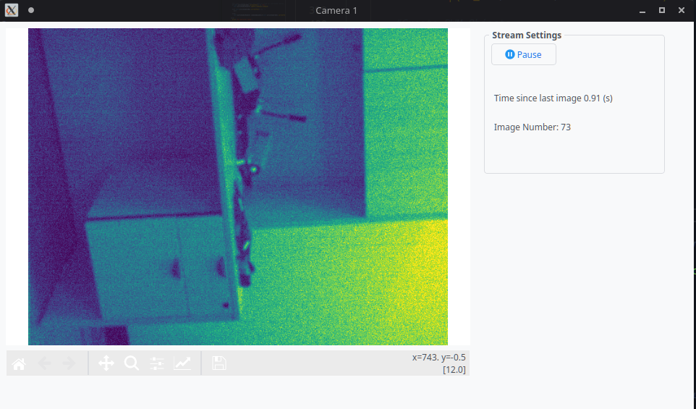
Step II: 3D PTV camera setup control
Remote camera control GUI via SSH
Panel for camera settings
Pitch and yaw alignment adjusted with feedback control GUI
Imaging settings: frame rate, exposure, etc.
Multi-camera preview streaming
Panel for video recording
Simple trigger with camera synchronization
Recording progress display
Notes:
Notes:
Launch the full remote camera control software and select from plugins
Record using .raw file for high fps
RGB mode for calibration imaging, BW for data acquisition
Software location: ~\Software\camera setup control

Slide 15
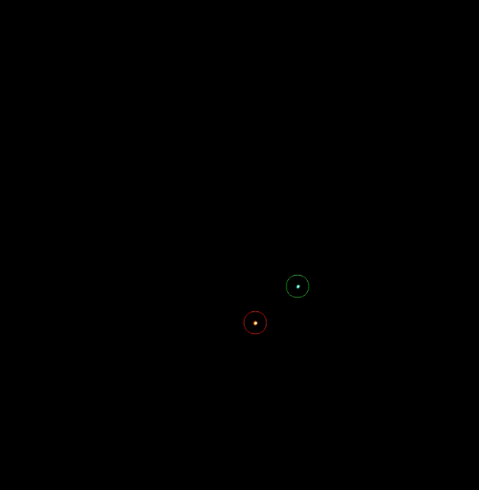
Step III: Calibration image pre-processing
Python script for pre-processing calibration images
Load raw images
Extract marker coordinates from calibration images
Automatically detect red and green dots
Save marker coordinates as .csv files
Export an .avi file with markers overlaid for result review
Raw calibration images
Markers identified
Notes:
Notes:
.raw format is used when recording to reach higher fps, needs decoding
Color setting: Calibration images are RGB for identifying red and green dots, tracking images are monochrome
Code: ~/Software/3DPTV_Processing_Pipeline/easyWand5/calibration image pre-processing

Slide 16
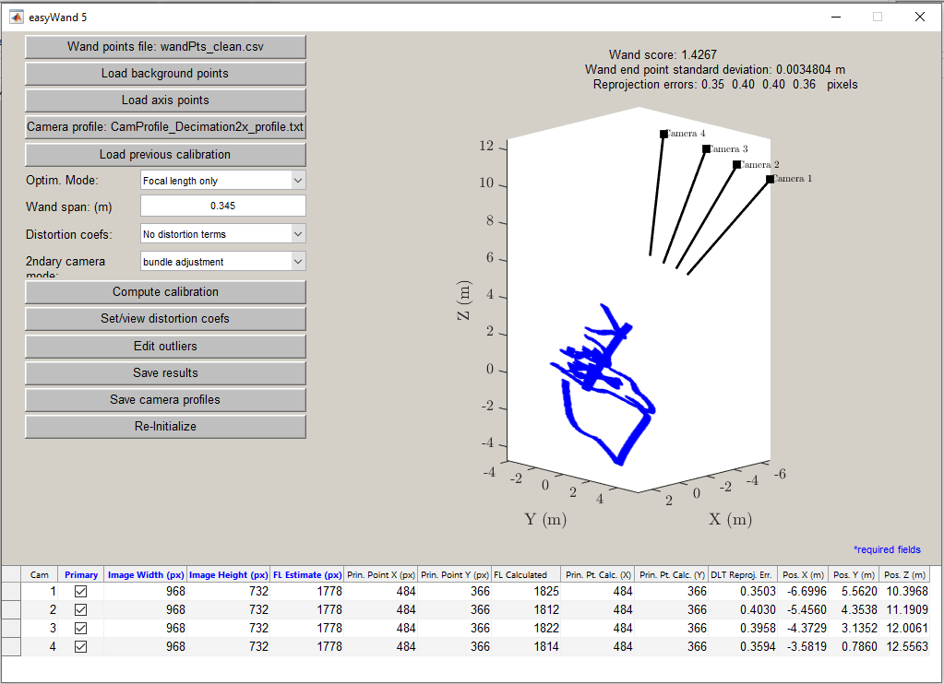
Step IV: Calibration (easyWand5)
Wand-based multi-camera calibration tool
GUI for calibrating 2 or more cameras using a calibration wand
Based on the MATLAB Computer Vision toolbox
Converts calibration results for use in OpenLPT
Recalculates calibration using the Tsai method employed in OpenLPT
Generates necessary configuration files for running OpenLPT
Notes:
Notes:
easyWand does not support Mac with Apple Silicon
Downloadable from: https://biomech.web.unc.edu/wand-calibration-tools/
Software path
easyWand5: ~/Software/3DPTV_Processing_Pipeline/easyWand5
Converting results: ~/Software/3DPTV_Processing_Pipeline/easyWand5/easyWand to OpenLPT

Slide 17
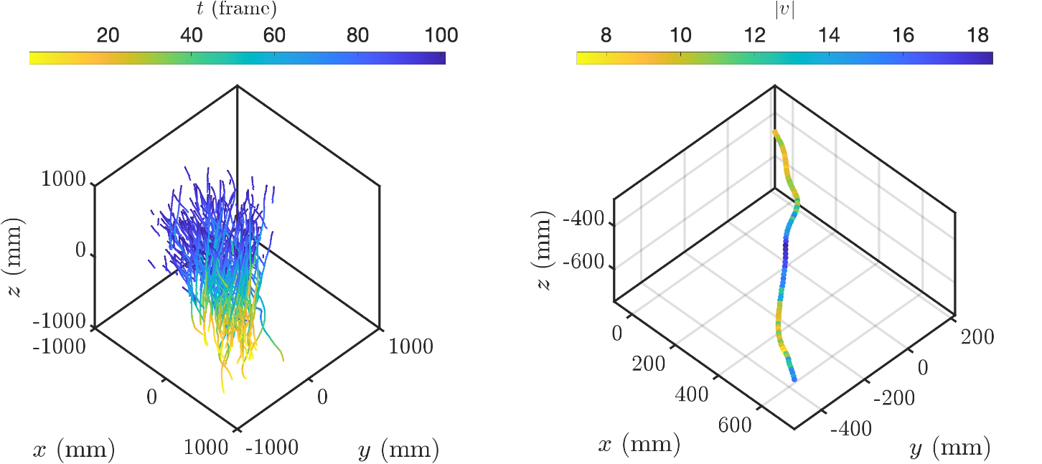
Step V and VI: 3D PTV tracking (OpenLPT) and visualization
OpenLPT: Open-source Lagrangian particle tracking code
Based on the Shake-the-Box method
Optimized for removing ghost particles at a high particle image density
Code for trajectory visualization is provided
Users can perform further analysis independently
Notes:
Notes:
1. Software path
OpenLPT package: ~/Software/3DPTV_Processing_Pipeline/OpenLPT - ShakeTheBox.zip
OpenLPT post processing: ~/Software/3DPTV_Processing_Pipeline/3D trajectory visualization
OpenLPT github page: https: //github.com/JHU-NI-LAB/OpenLPT_Shake-The-Box
References:
Tan, S., Salibindla, A., Masuk, A. U. M., & Ni, R. (2020). Introducing OpenLPT: new method of removing ghost particles and high-concentration particle shadow tracking. Experiments in Fluids, 61, 1-16.

Slide 18
Date Processing Procedure

Slide 19
Overview
Step 1: Extract calibration markers from raw images
Step 2: Run easyWand to generate the calibration profile
Step 3: Convert the calibration data to an OpenLPT-compatible format
Step 4: Use OpenLPT to obtain 3D particle coordinates
Step 5: 3D trajectory visualization

Slide 20
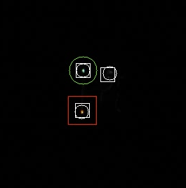
Step 1: Extract calibration markers from raw images
Organize raw image files into subfolders by camera under a single calibration folder
E.g., “/root_path/calA/cam1”
Run “droneMarkerTracking_v3.py” in “calibration image pre-processing ” folder
GUI pops up and select calibration folder
E.g., “/root_path/calA”
Images are processed from each camera and the results are displayed
White circles and boxes indicate identified markers, while red and green boxes represent the most confident marker identifications. The remaining white circles and boxes are filtered out.
Results will be saved in two files
wandPts_all.csv (nice to keep)
wandPts_clean.csv (cleaned up results with outliers filtered out based on path continuity)
Filtered out identifications
Calibration markers
Notes:
Notes:
Software path
Calibration image pre-processing: ~/Software/3DPTV_Processing_Pipeline/calibration image pre-processing

Slide 21
Step 2: Run easyWand to generate the calibration profile
Run easyWand5
Ensure the software is in “ ~/Documents/Matlab”.
Set this folder as the current directory in Matlab and enter easyWand5 in the command line.
Compute the initial calibration:
Load the previously generated wand points file (wandPts_clean.csv).
Click “Load camera profile” and select the appropriate file from the “Camera profiles” folder.
Set the wand span to the measured distance between the drone lights.
Leave other parameters as default and click “Compute Calibration.”
Refine calibration
Reprojection error will likely still be > 1 pixel, and wand score >>1
Press “edit outliers” → pick >one point to be removed with high residual → rerun compute calibration
Press “Save results” as .mat file
If needed, run Matlab script “cleanEasyWand.m” in “easyWand5/easyWand to OpenLPT” folder
load .mat file → filter out points with high error → resave a new calibration .mat file
In easyWand5, press “Load previous calibration”, and select newly saved .mat file
Press “Compute calibration”
Results should yield < 1 pixel reprojection errors → If so, save these results
If not, generate a “cleaner” calibration with a lower threshold value
Notes:
Notes:
Software path
easyWand package: ~/Software/3DPTV_Processing_Pipeline/easyWand5

Slide 22
Step 3: Convert the calibration data to an OpenLPT-compatible format
Create a folder for a new OpenLPT project
Add image files, saved in “/cam*/B*****.tif” format, where each camera has its own folder
Can convert from .raw to .tif using “convertImage.py” in “calibration image pre-processing/Utils”
This will be needed to match the config files generated below
In “easyWand5/easyWand to OpenLPT ”, run “easyWand2OpenLPT.m”
Will prompt to load the easyWand results file generated
This takes the 3D calibration points that easyWand has solved for, and uses them to recompute a new calibration using the Tsai method employed in the OpenLPT calibration tool
This also generates the needed configuration files for running OpenLPT
Note that scaling factor of 10 is important for OpenLPT not breaking down due to viewing area being too large
Notes:
Notes:
Software path
Conversion codes: ~/Software/easyWand5/easyWand to OpenLPT

Slide 23
Step 4 & 5: Obtain 3D coordinates via Open LPT and visualize trajectories
Installation
Follow the instructions in the “OpenLPT Instructions from JHU” folder to complete the installation.
Parameter setup
Configuration files are generated automatically, the following two files require particular attention:
trackingconfig.txt:
Keep the view area setting unchanged
iprconfig.txt:
mindist2d and mindist3d: Set equal to or greater than the calibration error (e.g., ~0.25)
Set the particle size accordingly.
Executing the Code
Open a command prompt in the OpenLPT root directory: “~/ShakeTheBox/Release_windows”
Run the executable using the following command with the OpenLPT project root:
.\ShakeTheBox "path-to-OpenLPT-project-root"
OpenLPT results
Output files are saved as .txt files in the “Tracks” folder
Results can be visualized using the scripts provided in the “3D Trajectory Visualization” folder
Notes:
Notes:
The C++ code for OpenLPT needs to be compiled
In trackingconfig.txt: The view area setting should remain unchanged (even though it appears very small, in mm).
Software path, OpenLPT: ~/Software/OpenLPT – ShakeTheBox
Software path, trajectory visualization: ~/Software/3D trajectory visualization

Slide 24
Demonstration Cases

Slide 25
Case I: Confetti Settling

Slide 26
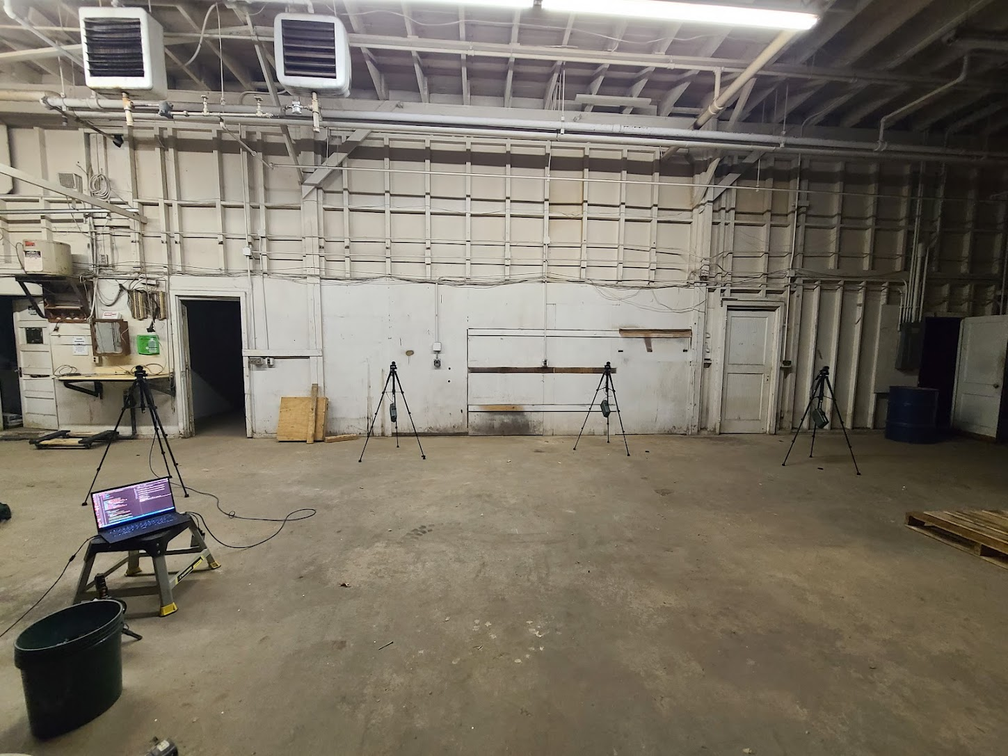
Experimental Setup
This example serves as a concept validation for the 3D PTV system
Case description and planning
Confetti particles made from 6 mm diameter paper hole punches, hand tossed and fall freely
Sampling volume: 3 m ⨉ 3 m ⨉ 2 m, volume center height: 1 m
Raw particle images
Notes:
Notes:
This case was for concept validation in Bristow 2023 EXIF, paper in ~/Field3D_PTV/papers
Data: ~/Field3D_PTV/Demonstration cases/Case I_Confetti settling
Reference:
Bristow, N., Li, J., Hartford, P., Guala, M., & Hong, J. (2023). Imaging-based 3D particle tracking system for field characterization of particle dynamics in atmospheric flows. Experiments in Fluids, 64(4), 78.

Slide 27
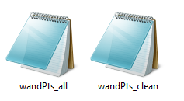
Extract marker coordinates from raw calibration images
Find “droneMarkerTracking_v3.py” in “calibration image pre-processing” folder
Select path to raw calibration images and run the code
Marker coordinates are exported as .csv files for easyWand calibration in the next step
Raw calibration images
Markers identified and coordinates saved as .csv files
Notes:
Notes:
Inout: raw marker image; opt put: wand point coordinates
Color setting: Calibration images are RGB for identifying red and green dots, tracking images are bw
More details in “Data Processing Procedure”, the code generates .avi file with marker noted for verification
The calibration working folder, named “calibration\_proc\_folder,” is included in each demo case.
Code: ~/Software/3DPTV_Processing_Pipeline/calibration image pre-processing
Data: ~/Field3D_PTV/Demonstration cases/Case I_Confetti settling/calibration_proc_folder

Slide 28
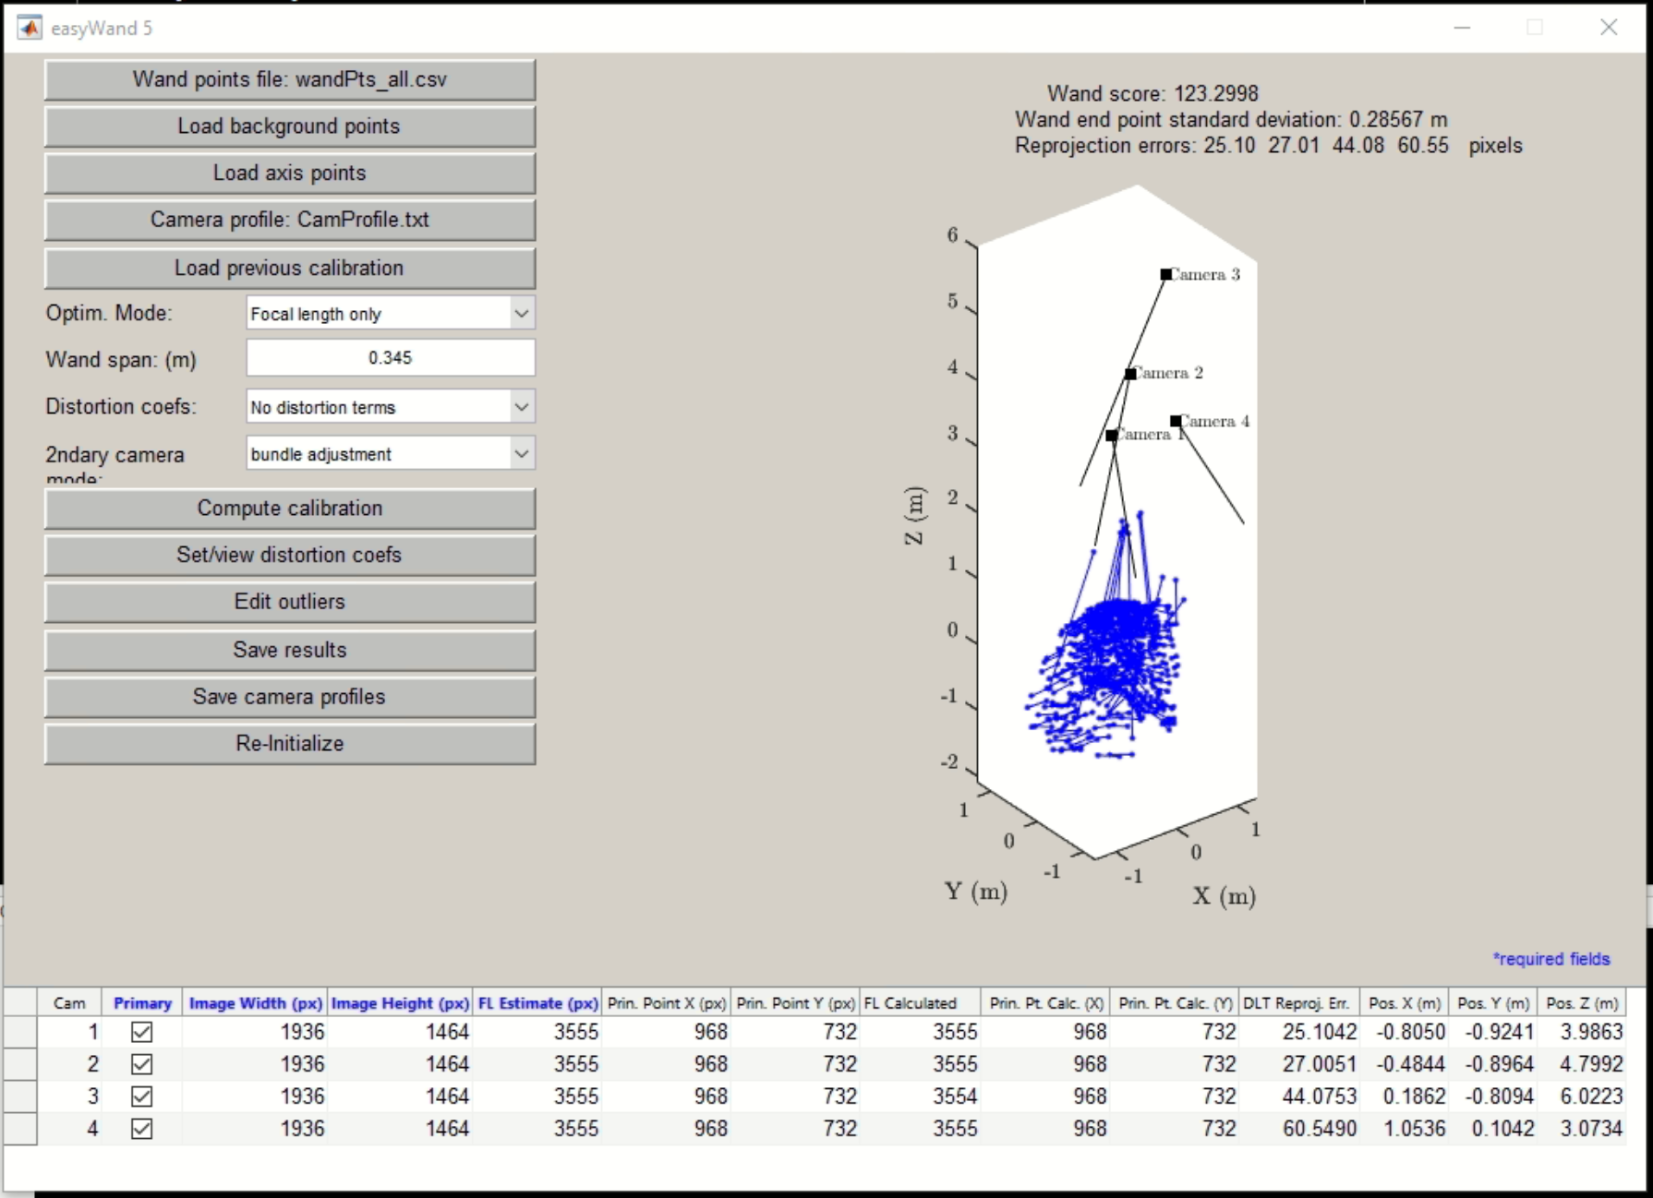
Compute Calibration Profile
Run “easyWand5” in Matlab, load wand points and camera profile, enter wand spam, compute calibration
The first result can be with large error, use “Edit outliers” to refine results
Notes:
Notes:
Input: wand point coordinates, camera profile, wand span
Wand span: 34.5 cm
Camera profile: ~/Software/3DPTV_Processing_Pipeline/Camera profiles
Code: ~/Software/3DPTV_Processing_Pipeline/easyWand5
Data: ~/Field3D_PTV/Demonstration cases/Case I_Confetti settling/calibration_proc_folder

Slide 29
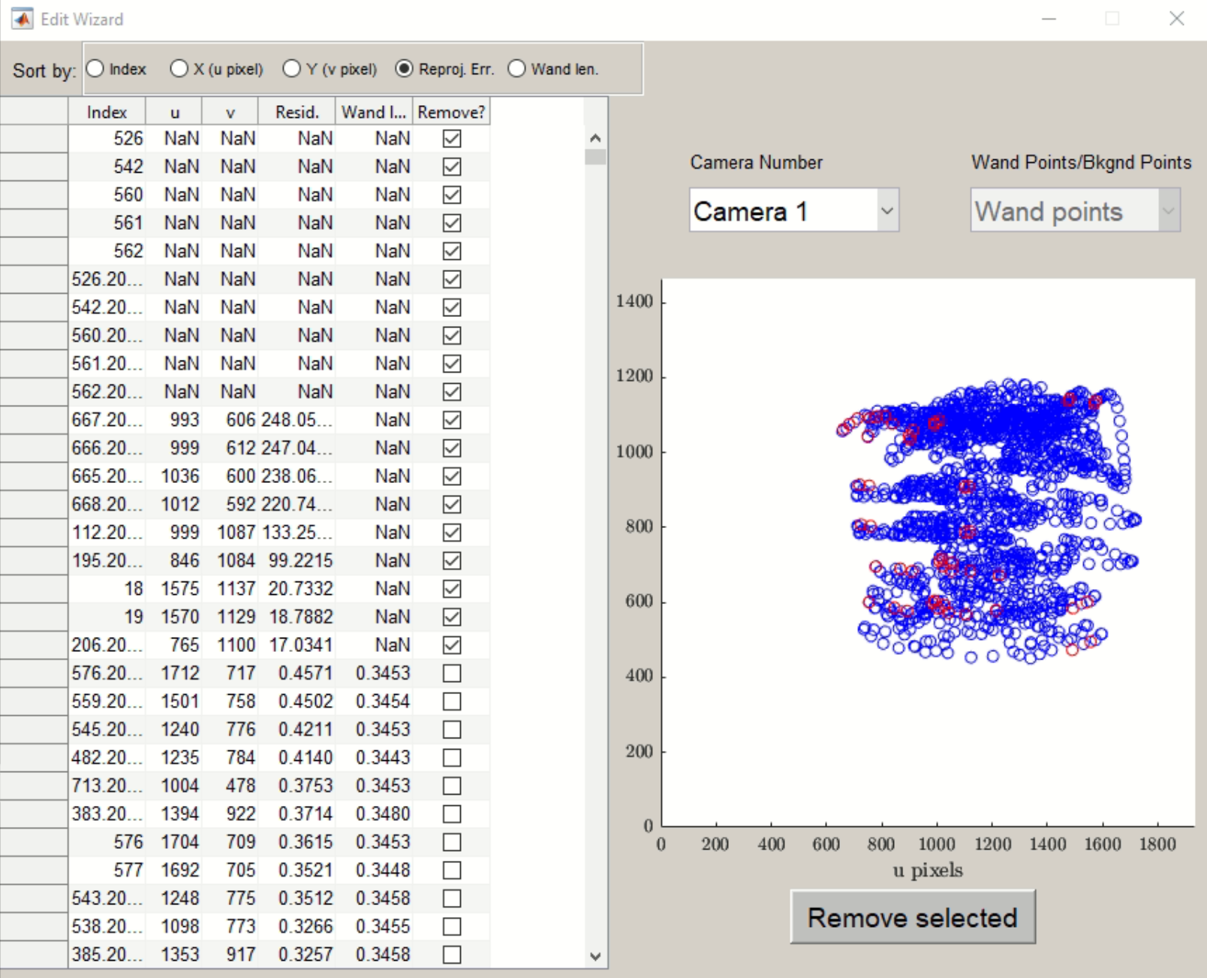
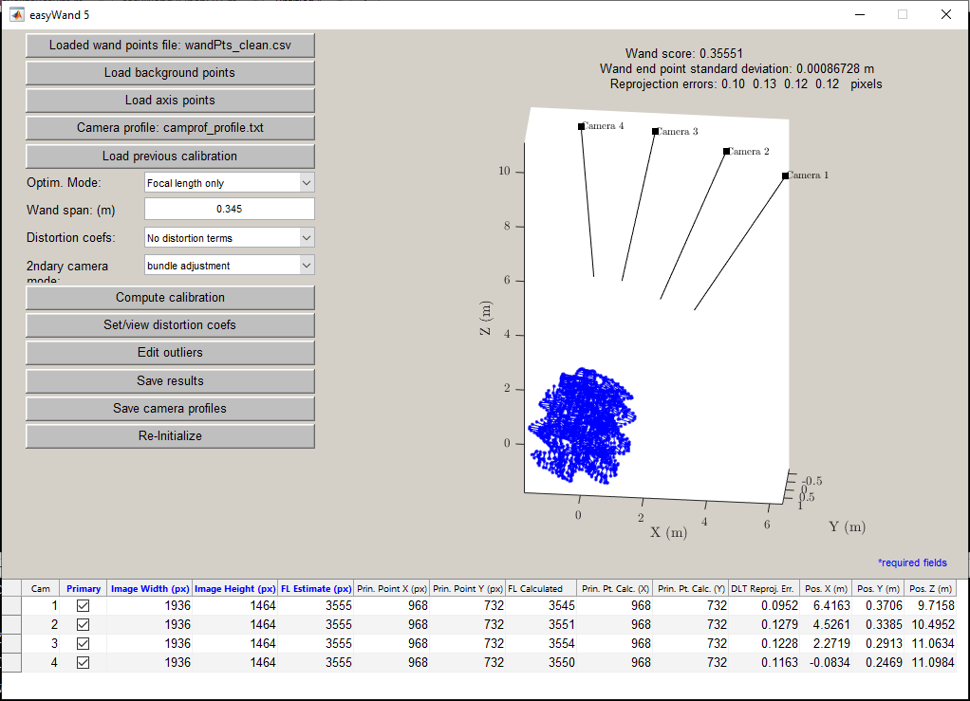
Refine Calibration Profile
Sort calibration points by the residual, remove results that are significantly larger
Compute calibration again, check wand score and errors, repeat previous step again
Use “cleanEasyWand.m” in “easyWand5/easyWand to OpenLPT ” folder to filter results if needed
Save results (.mat file) when the wand score and error meet the desired criteria
Notes:
Notes:
Should target for wand score <1 and pix error <<1
Output: .mat file from easyWand calibration
Code: ~/Software/3DPTV_Processing_Pipeline/easyWand5/easyWand to OpenLPT
Data: ~/Field3D_PTV/Demonstration cases/Case I_Confetti settling/calibration_proc_folder

Slide 30
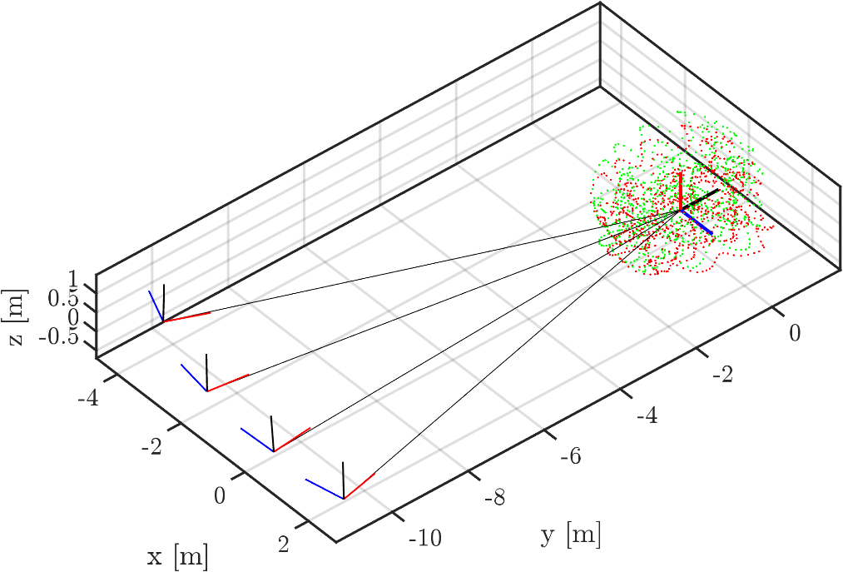
Calibration Results
Wand quality score: 0.35
Wand end point standard deviation: 0.8 mm (total wand length: 34.5 cm)
Reprojection error of each camera (Cam 1: 0.1 pix; Cam 2: 0.13 pix; Cam 3: 0.12 pix; Cam 4: 0.12 pix)
Wand score of 1 or less indicates a good calibration (STD/mean = 1% )
Run code “easyWand2OpenLPT.m” to export config files for OpenLPT
Notes:
Notes:
Input: .mat file from easyWand calibration; Output: config files for OpenLPT
The code also converts the coordinate system
Code: ~/Software/3DPTV_Processing_Pipeline/easyWand5/easyWand to OpenLPT
Data: ~/Field3D_PTV/Demonstration cases/Case I_Confetti settling/calibration_proc_folder

Slide 31
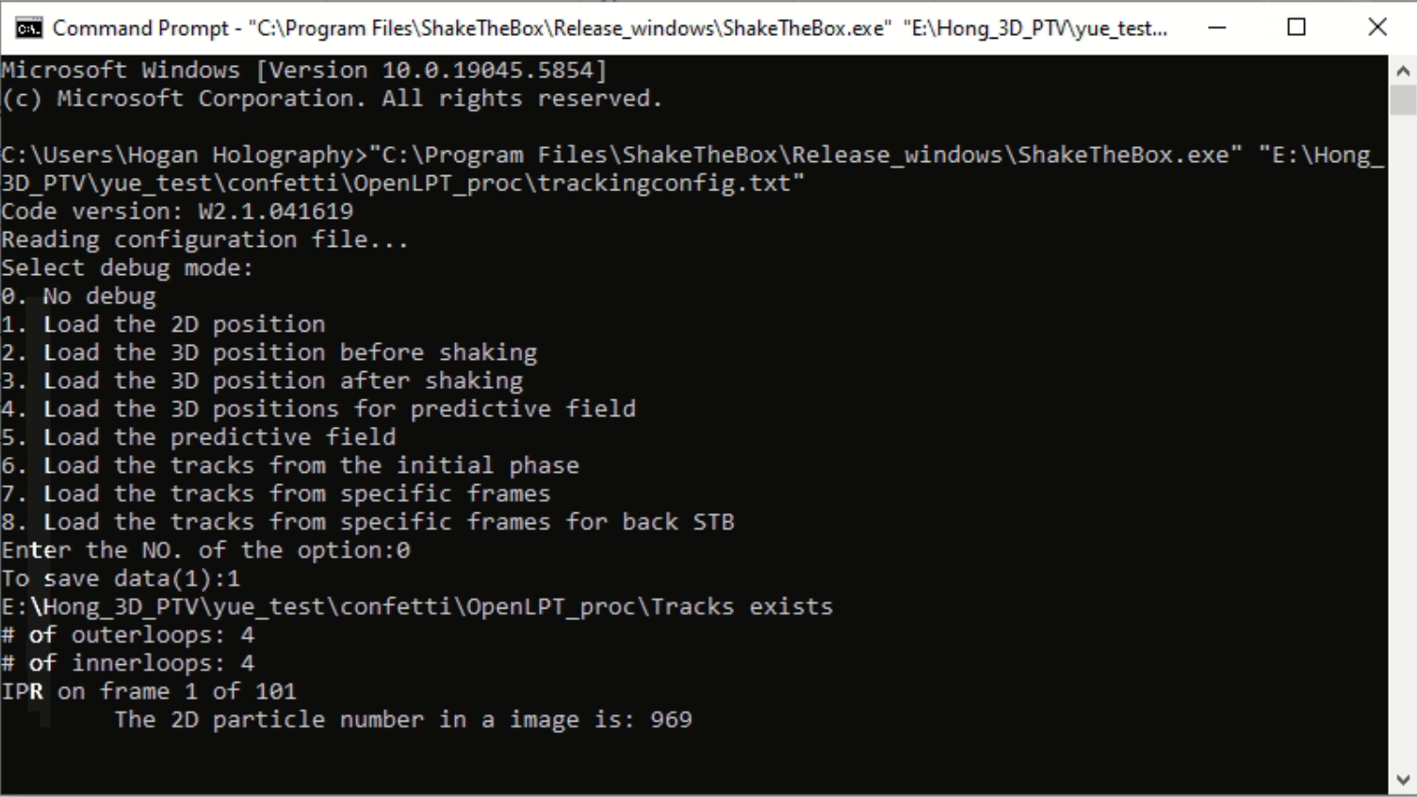
3D Coordinate Calculation using OpenLPT
Create project folder for OpenLPT, organize .tif images into the /cam*/ folders
Convert easyWand results to OpenLPT configuration files (Use “easyWand2OpenLPT.m” in “easyWand5/easyWand to OpenLPT ”)
Run OpenLPT (in command window, enter “path-to-ShakeTheBox\ShakeTheBox.exe” “path-to-data\OpenLPT_proc\trackingconfig.txt”)
Results are saved in “Tracks” folder as txt files
Notes:
Notes:
Make sure path in the configuration files are correct
The OpenLPT working folder is “OpenLPT_proc_folder”, provided in each demo cases
Data: ~/Field3D_PTV/Demonstration cases/Case I_Confetti settling/OpenLPT_proc_folder

Slide 32
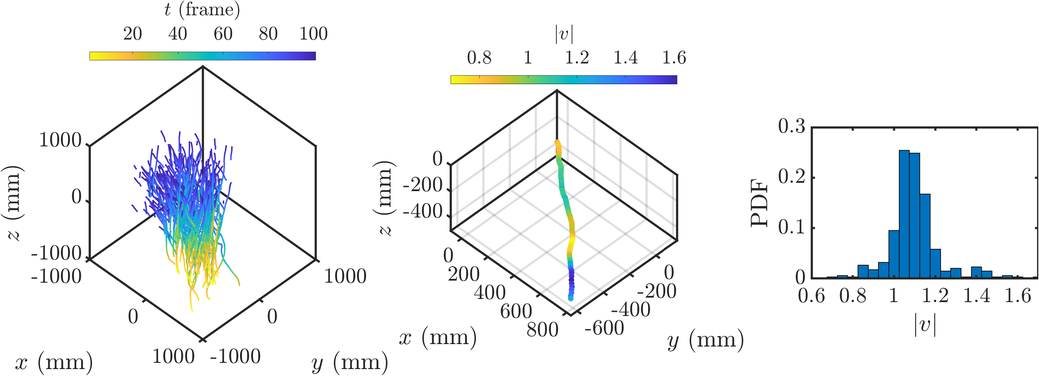
Trajectory Visualization and Post-processing
Trajectory yield: 93% of particles successfully captured by the system (464/501)
Fall speed evaluation: PTV fall speed measurements closely matched independently measured values for individual confetti particles (~1m/s)
Trajectory analysis: Captured fine-scale motions accurately, reveals details of tumbling motions of the confetti particles
(m/s)
(m/s)
Notes:
Notes:
Run VisualizeResults_2.m to visualize tracks and analyze velocity distribution
Location: ~\Code\3DPTV_Processing_Pipeline\3D trajectory visualization\VisualizeResults_3

Slide 33
Case II: Snow Settling

Slide 34
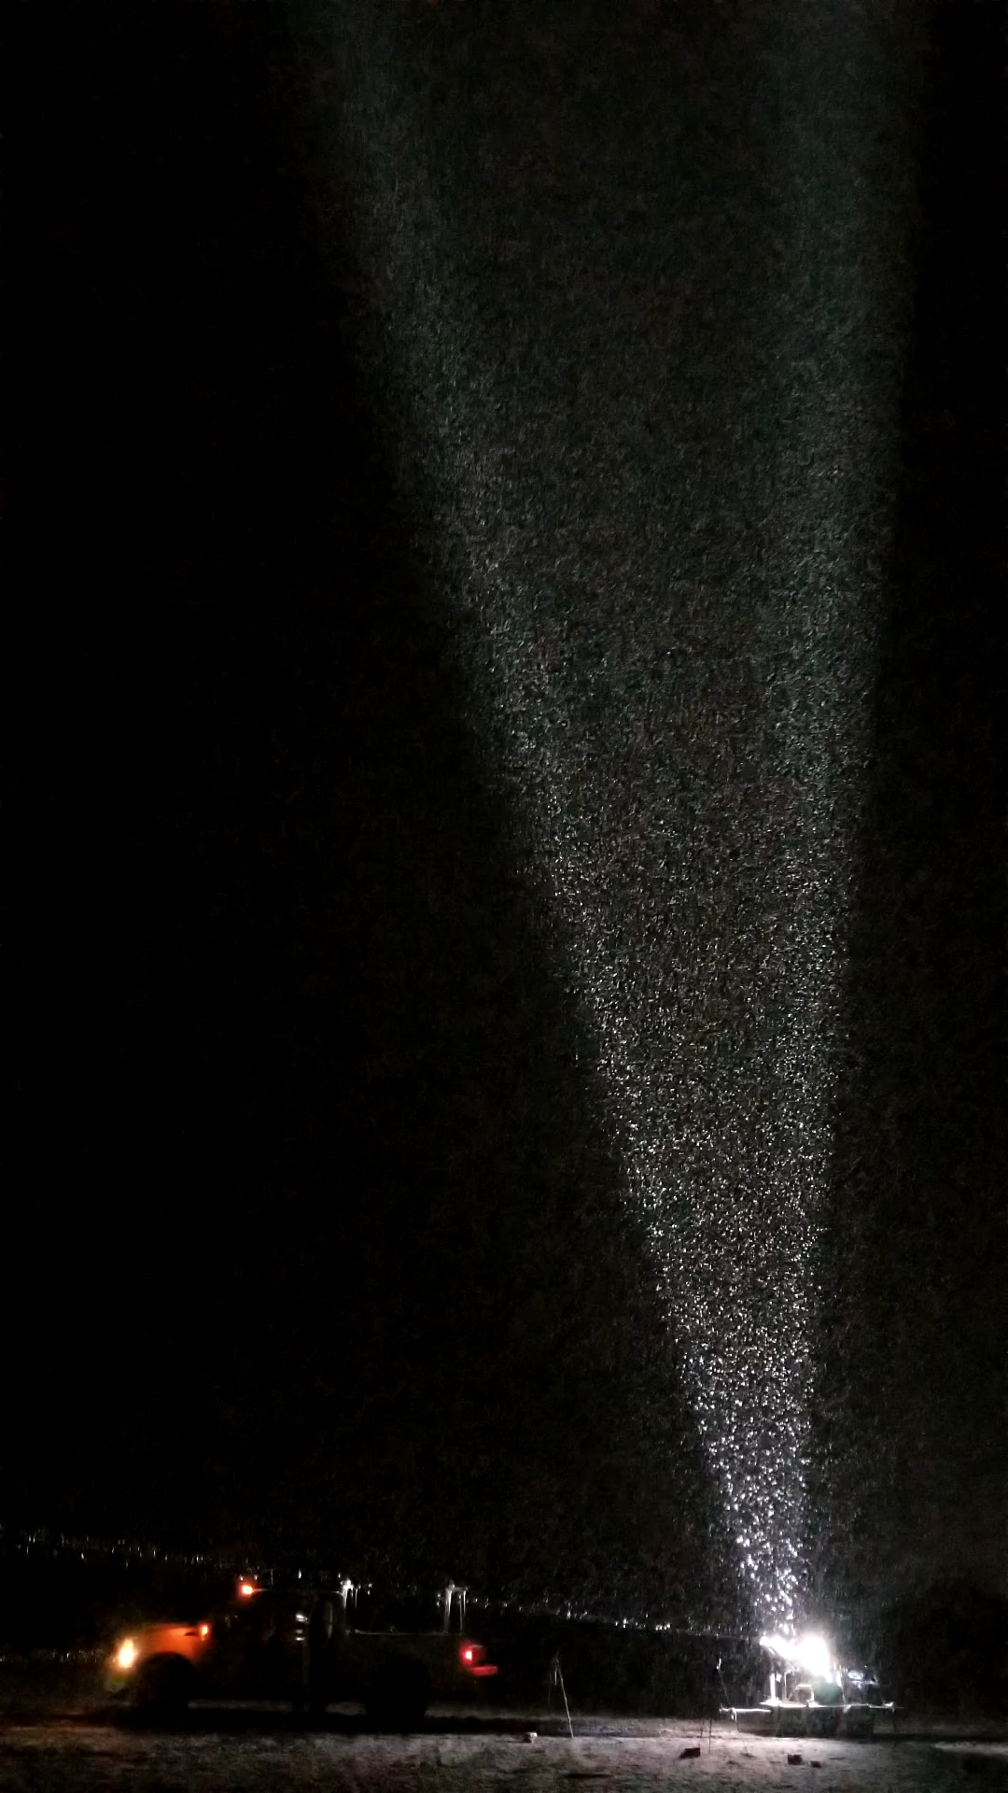
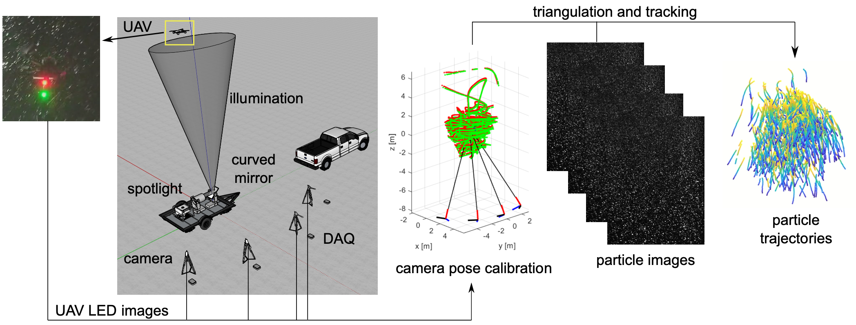
Experimental Setup
Investigation on snow settling under different atmospheric conditions
Low turbulence (snow morphology play a role)
Imaging 4 m ⨉ 4 m ⨉ 6 m volume, ~ 10 m above ground
Spatial resolution 6.3 mm/voxel; temporal resolution 200 Hz
Duration: in total 26 50-second sequences
Notes:
Notes:
This case was the main experiment in Bristow 2023 EXIF, paper in ~/Field3D_PTV/papers
Data: ~/Field3D_PTV/Demonstration cases/Case II_Snow
Reference:
Bristow, N., Li, J., Hartford, P., Guala, M., & Hong, J. (2023). Imaging-based 3D particle tracking system for field characterization of particle dynamics in atmospheric flows. Experiments in Fluids, 64(4), 78.

Slide 35
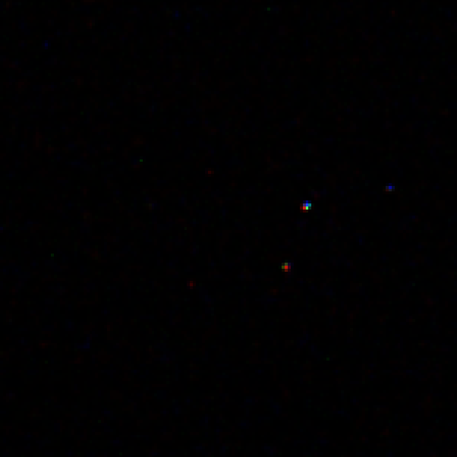
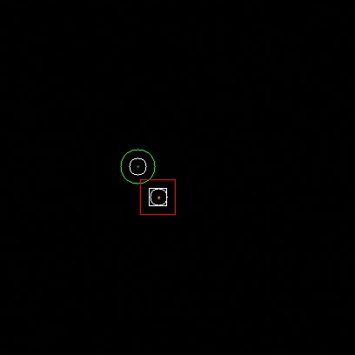
Extract marker coordinates from raw calibration images
Extract marker coordinates from raw calibration images
Find “droneMarkerTracking_v3.py” in “calibration image pre-processing” folder
Select path to raw calibration images and run the code
Marker coordinates are exported as .csv files for easyWand calibration in the next step
Notes:
Notes:
Inout: raw marker image; opt put: wand point coordinates
Color setting: Calibration images are RGB for identifying red and green dots, tracking images are bw
More details in “Data Processing Procedure”, the code generates .avi file with marker noted for verification
The calibration working folder, named “calibration\_proc\_folder,” is included in each demo case.
Code: ~/Software/3DPTV_Processing_Pipeline/calibration image pre-processing
Data: ~/Field3D_PTV/Demonstration cases/Case II_Snow/calibration_proc_folder

Slide 36
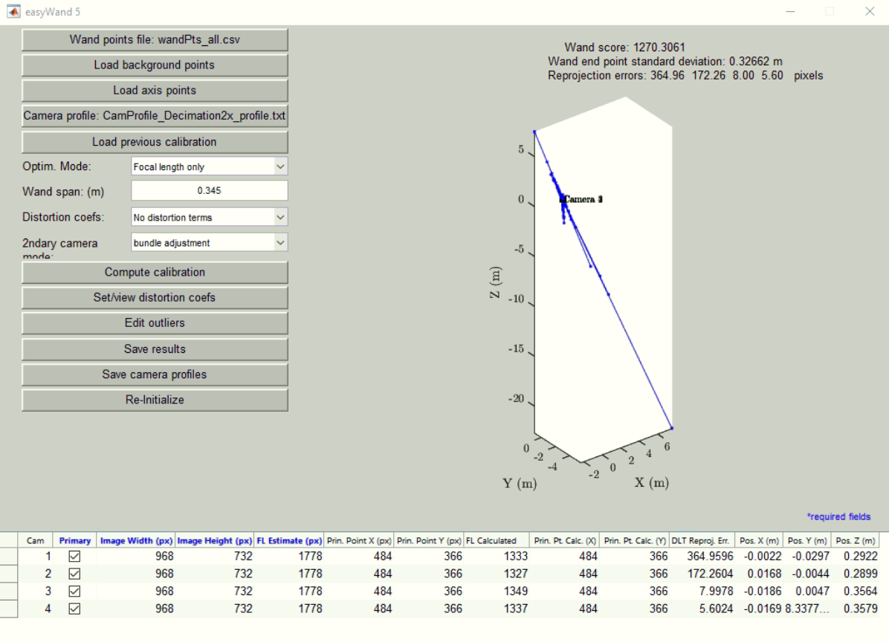
Compute Calibration Profile
Compute calibration profile
Run “easyWand5” in Matlab, load wand points and camera profile (Decimation2X), enter wand spam, compute calibration
The first result is with large error, use “Edit outliers” to refine results
Notes:
Notes:
Input: wand point coordinates, camera profile, wand span
Wand span: 0.345m
Camera profile: ~/Software/3DPTV_Processing_Pipeline/Camera profiles
Code: ~/Software/3DPTV_Processing_Pipeline/easyWand5
Data: ~/Field3D_PTV/Demonstration cases/Case II_Snow/calibration_proc_folder

Slide 37
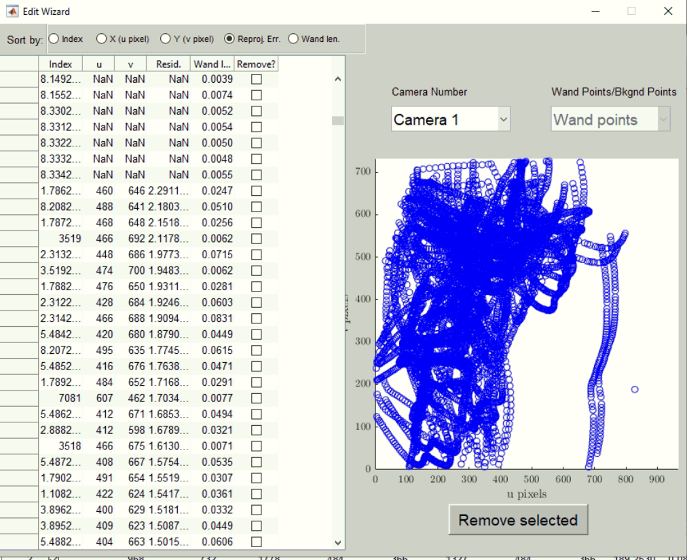
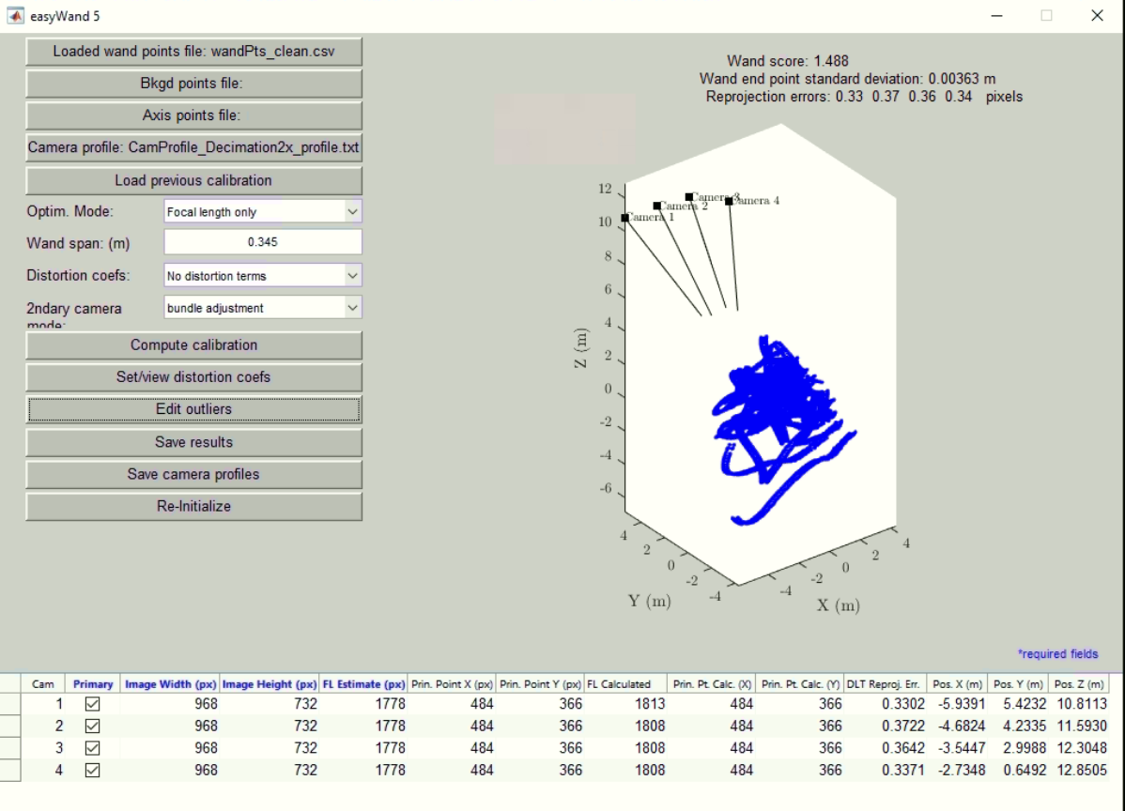
Refine Calibration Profile
Refine calibration profile
Sort calibration points by the residual, remove results that are significantly larger
Use “cleanEasyWand.m” in “easyWand5/easyWand to OpenLPT ” to filter results
When desired Wand score is achieved, save results (.mat file) when the wand score and error meet the desired criteria
Notes:
Notes:
Should target for wand score ~1 and pix error <1
Output: .mat file from easyWand calibration
Code: ~/Software/3DPTV_Processing_Pipeline/easyWand5/easyWand to OpenLPT
Data: ~/Field3D_PTV/Demonstration cases/Case II_Snow/calibration_proc_folder

Slide 38
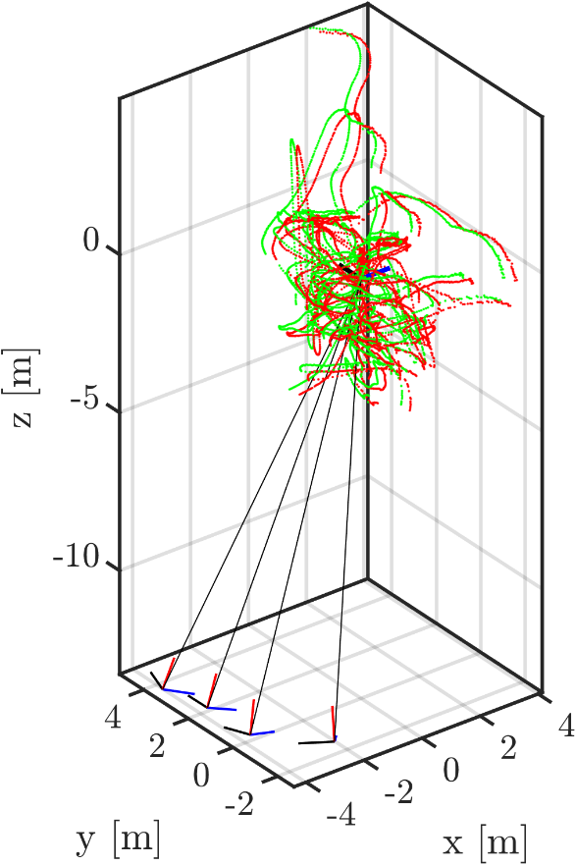
Calibration Results
Calibration result analysis
Wand quality score: 1.48
Wand end point standard deviation: 3.6 mm (total wand length: 34.5 cm)
Reprojection error of each camera
Cam 1: 0.33 pix
Cam 2: 0.37 pix
Cam 3: 0.36 pix
Cam 4: 0.34 pix
Wand score of 1 or less indicates a good calibration (STD/mean = 1% )
Run code “easyWand2OpenLPT.m” to convert coordinate system and export config files for OpenLPT
Notes:
Notes:
Input: .mat file from easyWand calibration; Output: config files for OpenLPT
The code also converts the coordinate system
Every 10th image was included in the data to reduce size. This subset is sufficient for calibration, with minor result variations possible.
Code: ~/Software/3DPTV_Processing_Pipeline/easyWand5/easyWand to OpenLPT
Data: ~/Field3D_PTV/Demonstration cases/Case II_Snow settling/calibration_proc_folder

Slide 39
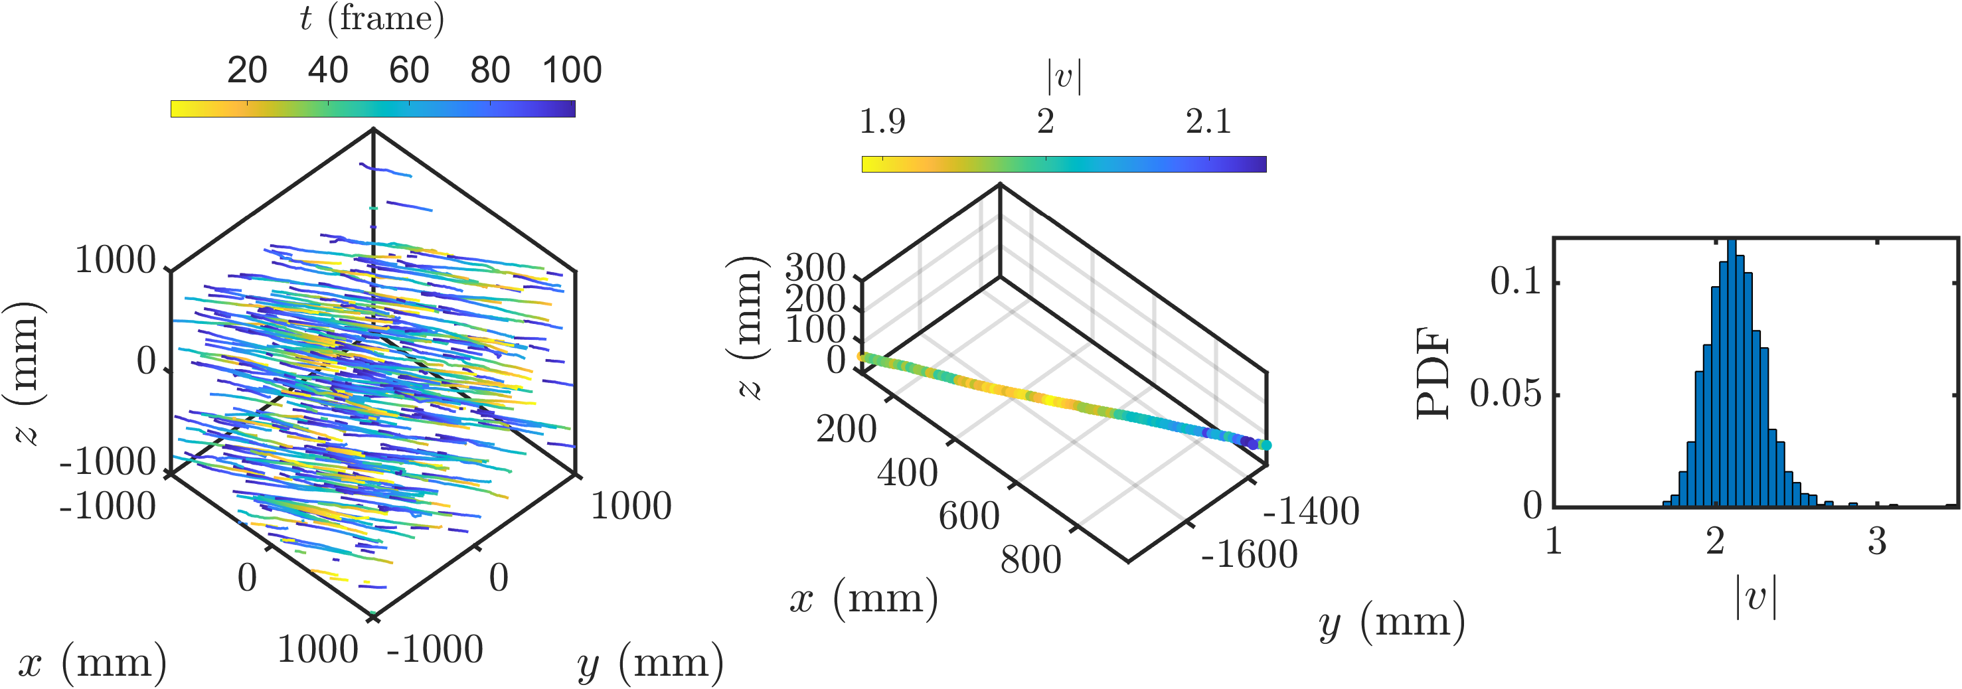
Trajectory Visualization and Post-processing
Process images using OpenLPT
Create project folder for OpenLPT, organize .tif images into the /cam*/ folders
Convert easyWand results to OpenLPT configuration files (Use “easyWand2OpenLPT.m” in “easyWand5/easyWand to OpenLPT ”)
Run OpenLPT (in command window, enter “path-to-ShakeTheBox\ShakeTheBox.exe” “path-to-data\OpenLPT_proc\trackingconfig.txt”)
Results are saved in “Tracks” folder as .txt files
Further process the tracking data to extract information; additional details are available in the paper.
(m/s)
(m/s)
Notes:
Notes:
Code: ~/Field3D_PTV/Demonstration cases/Case II_Snow settling/3D trajectory visualization
Data: ~/Field3D_PTV/Demonstration cases/Case II_Snow settling/results_fig
Reference:
Bristow, N., Li, J., Hartford, P., Guala, M., & Hong, J. (2023). Imaging-based 3D particle tracking system for field characterization of particle dynamics in atmospheric flows. Experiments in Fluids, 64(4), 78.

Slide 40
Case III: Pollen Dispersion

Slide 41
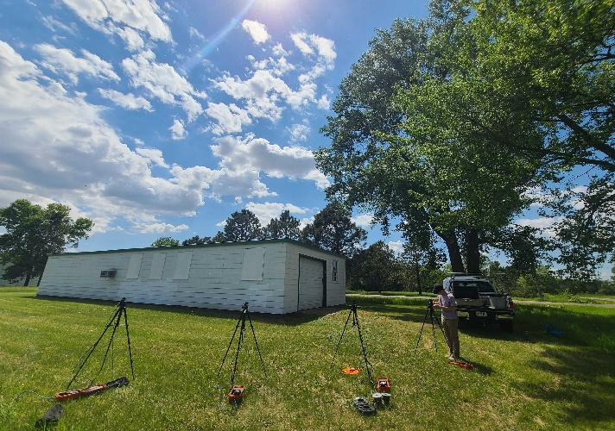
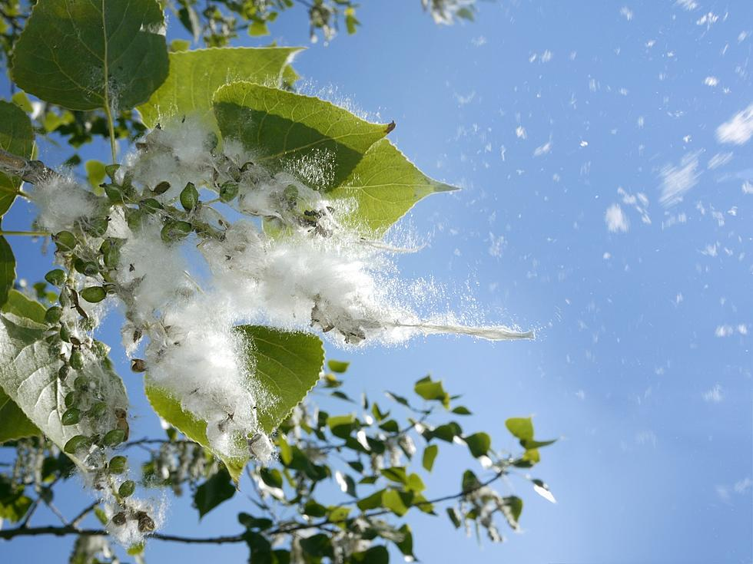
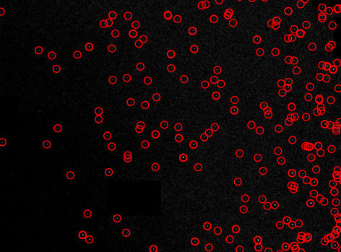
Experimental Setup
Investigation into pollen particle emission from a cottonwood tree
Deployments of the system done over Summer 2022 during a time of high pollen density
Used 3D PTV system to obtain particle tracks of cottonwood pollen during the daytime
A better understanding of pollen emission can potentially improve forecasting for people with allergies
Notes:
Notes:
Data: ~/Field3D_PTV/Demonstration cases/Case III_Pollen Dispersion

Slide 42
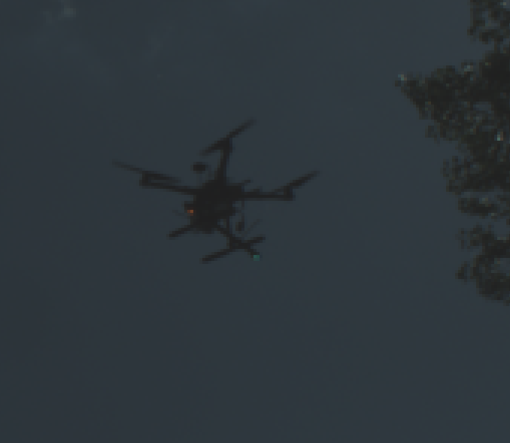
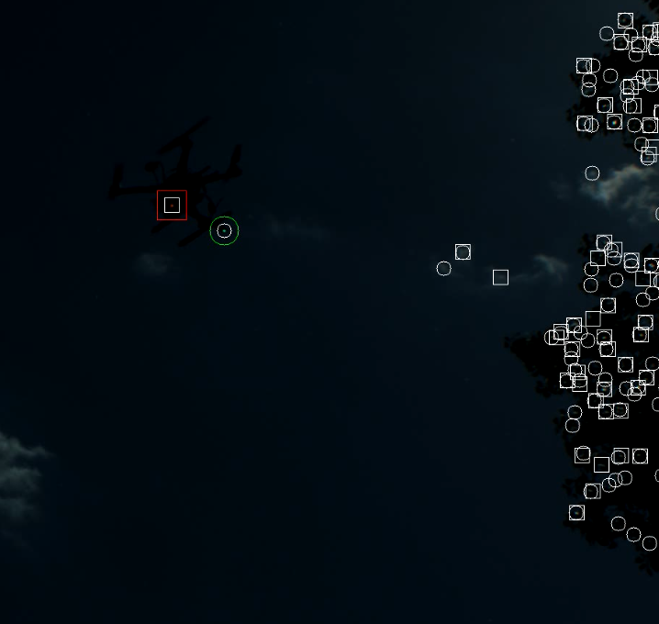
Extract marker coordinates from raw calibration images
Extract marker coordinates from raw calibration images
Find “droneMarkerTracking_v3.py” in “calibration image pre-processing” folder
Select path to raw calibration images and run the code
Marker coordinates are exported as .csv files for easyWand calibration in the next step
Notes:
Notes:
Inout: raw marker image; opt put: wand point coordinates
Color setting: Calibration images are RGB for identifying red and green dots, tracking images are bw
More details in “Data Processing Procedure”, the code generates .avi file with marker noted for verification
1 out of every 10 images was used to reduce the pack size. This reduced set has been shown to be sufficient for identifying the calibration matrix.
The calibration working folder, named “calibration\_proc\_folder,” is included in each demo case.
Code: ~/Software/3DPTV_Processing_Pipeline/calibration image pre-processing
Data: ~/Field3D_PTV/Demonstration cases/Case III_Pollen Dispersion/calibration_proc_folder

Slide 43
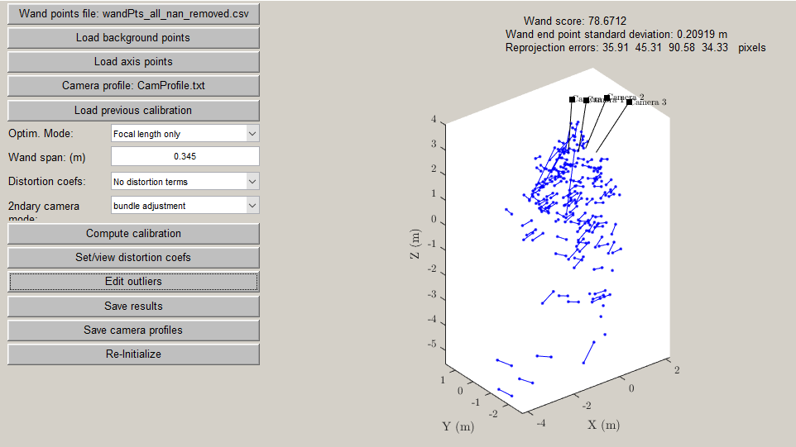
Compute Calibration Profile
Compute calibration profile
Run “easyWand5” in Matlab, load wand points and camera profile (Decimation2X), enter wand spam, compute calibration
The first result is with large error, use “Edit outliers” to refine results
Notes:
Notes:
Input: wand point coordinates, camera profile, wand span
Wand span: 0.345m
Camera profile: ~/Software/3DPTV_Processing_Pipeline/Camera profiles
Code: ~/Software/3DPTV_Processing_Pipeline/easyWand5
Data: ~/Field3D_PTV/Demonstration cases/Case III_Pollen Dispersion/calibration_proc_folder

Slide 44
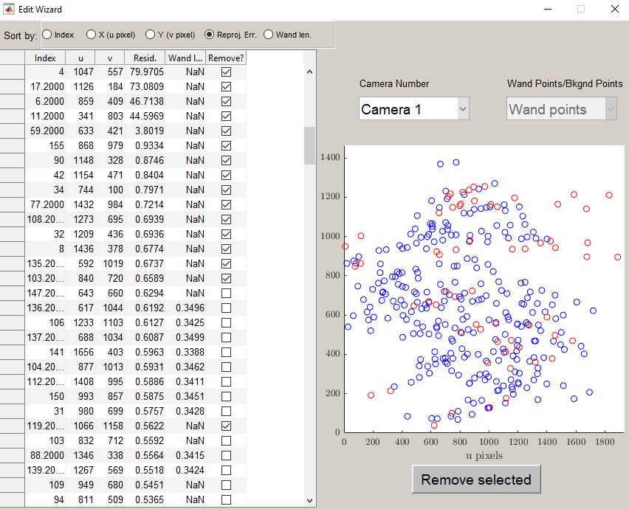
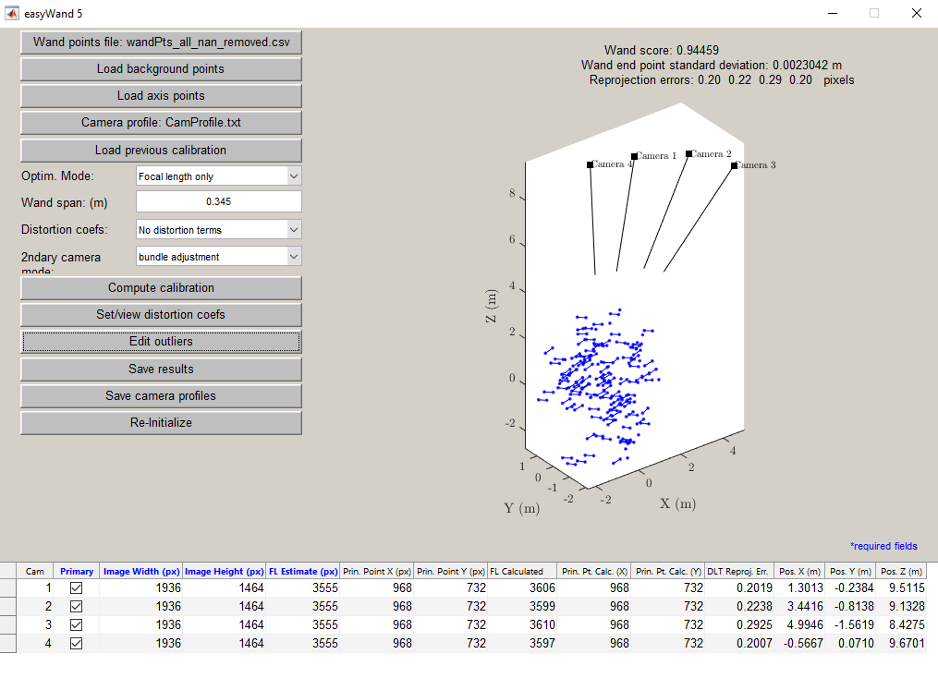
Refine Calibration Profile
Refine calibration profile
Sort calibration points by the residual, remove results that are significantly larger
Use “cleanEasyWand.m” in “easyWand5/easyWand to OpenLPT ” to filter results
When desired Wand score is achieved, save results (.mat file) when the wand score and error meet the desired criteria
Notes:
Notes:
Should target for wand score ~1 and pix error <1
Output: .mat file from easyWand calibration
Code: ~/Software/3DPTV_Processing_Pipeline/easyWand5/easyWand to OpenLPT
Data: ~/Field3D_PTV/Demonstration cases/Case III_Pollen Dispersion/calibration_proc_folder

Slide 45
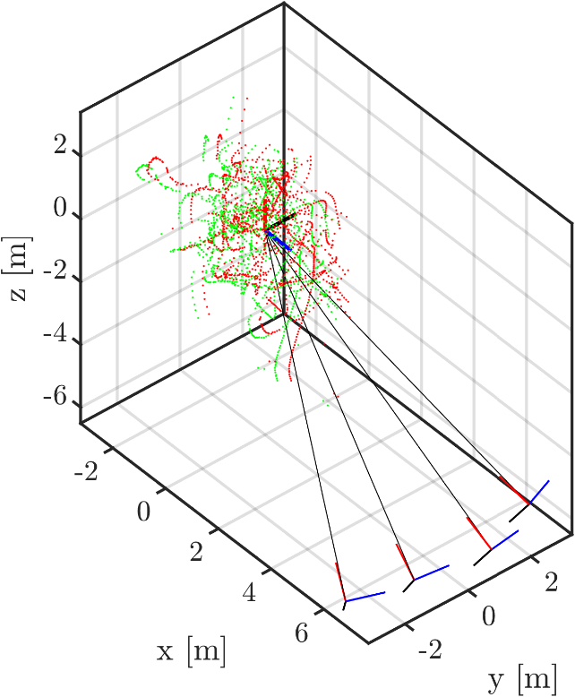
Calibration Results
Wand quality score: 0.94
Wand end point standard deviation: 2 mm (total wand length: 34.5 cm)
Reprojection error of each camera (Cam 1: 0.2 pix; Cam 2: 0.29 pix; Cam 3: 0.29 pix; Cam 4: 0.20 pix)
Wand score of 1 or less indicates a good calibration (STD/mean = 1% )
Run code “easyWand2OpenLPT.m” to export config files for OpenLPT
Notes:
Notes:
Input: .mat file from easyWand calibration; Output: config files for OpenLPT
The code also converts the coordinate system
Code: ~/Software/3DPTV_Processing_Pipeline/easyWand5/easyWand to OpenLPT
Data: ~/Field3D_PTV/Demonstration cases/Case III_Pollen Dispersion/calibration_proc_folder

Slide 46
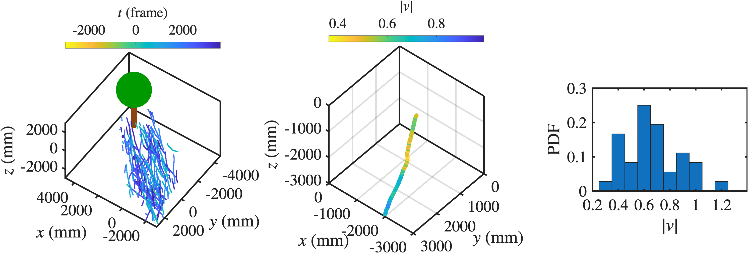
Trajectory Visualization and Post-processing
Process images using OpenLPT
Create project folder for OpenLPT, organize .tif images into the /cam*/ folders
Convert easyWand results to OpenLPT configuration files (Use “easyWand2OpenLPT.m” in “easyWand5/easyWand to OpenLPT ”)
Run OpenLPT (in command window, enter “path-to-ShakeTheBox\ShakeTheBox.exe” “path-to-data\OpenLPT_proc\trackingconfig.txt”)
Results are saved in “Tracks” folder as .txt files
Further process the tracking data to extract information; additional details are available in the paper.
Notes:
Notes:
Tree shape and location for illustration only
Due to file size constraints, the demo case includes 200 raw image frames for user testing. Tracking results for these 200 frames are included.
The full tracking results are also included for visualization demo purposes:
Full tracking results location: ~/Field3D_PTV/Demonstration cases/Case III_Pollen Dispersion/OpenLPT_proc_folder/Tracks_Full
Data: ~/Field3D_PTV/Demonstration cases/Case III_Pollen Dispersion/3D trajectory visualization

Slide 47



Trajectory Visualization and Post-processing
Process images using OpenLPT
Create project folder for OpenLPT, organize .tif images into the /cam*/ folders
Convert easyWand results to OpenLPT configuration files (Use “easyWand2OpenLPT.m” in “easyWand5/easyWand to OpenLPT ”)
Run OpenLPT (in command window, enter “path-to-ShakeTheBox\ShakeTheBox.exe” “path-to-data\OpenLPT_proc\trackingconfig.txt”)
Results are saved in “Tracks” folder as .txt files
Further process the tracking data to extract information; additional details are available in the paper.
Notes:
Notes:
Make sure path in the configuration files are correct
Data: ~/Field3D_PTV/Demonstration cases/Case III_Pollen Dispersion/3D trajectory visualization

